Slide 1





Web Scraping & Web Services

Slide 2

Hello!
I am Eslam Ahmed
I am a software engineer.
You can find me at jeksogsa@gmail.com

Slide 3
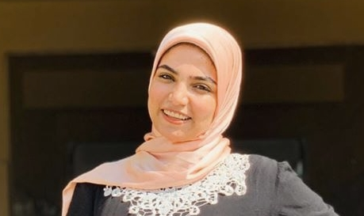
Hello!
I am Eman Ehab
I am a ML research engineer.
You can find me at emanehab.ieee@gmail.com

Slide 4
Agenda
What is Network Topologies
What is Internet and Web Servers
HTTP Request/Response Cycle
HTML
CSS
Scrapping Concept
BeautifulSoap Library
REST API Web Services
Work with JSON

Slide 5
Agenda
What is Network Topologies
What is Internet and Web Servers
HTTP Request/Response Cycle
HTML
CSS
Scrapping Concept
BeautifulSoap Library
REST API Web Services
Work with JSON

Slide 6
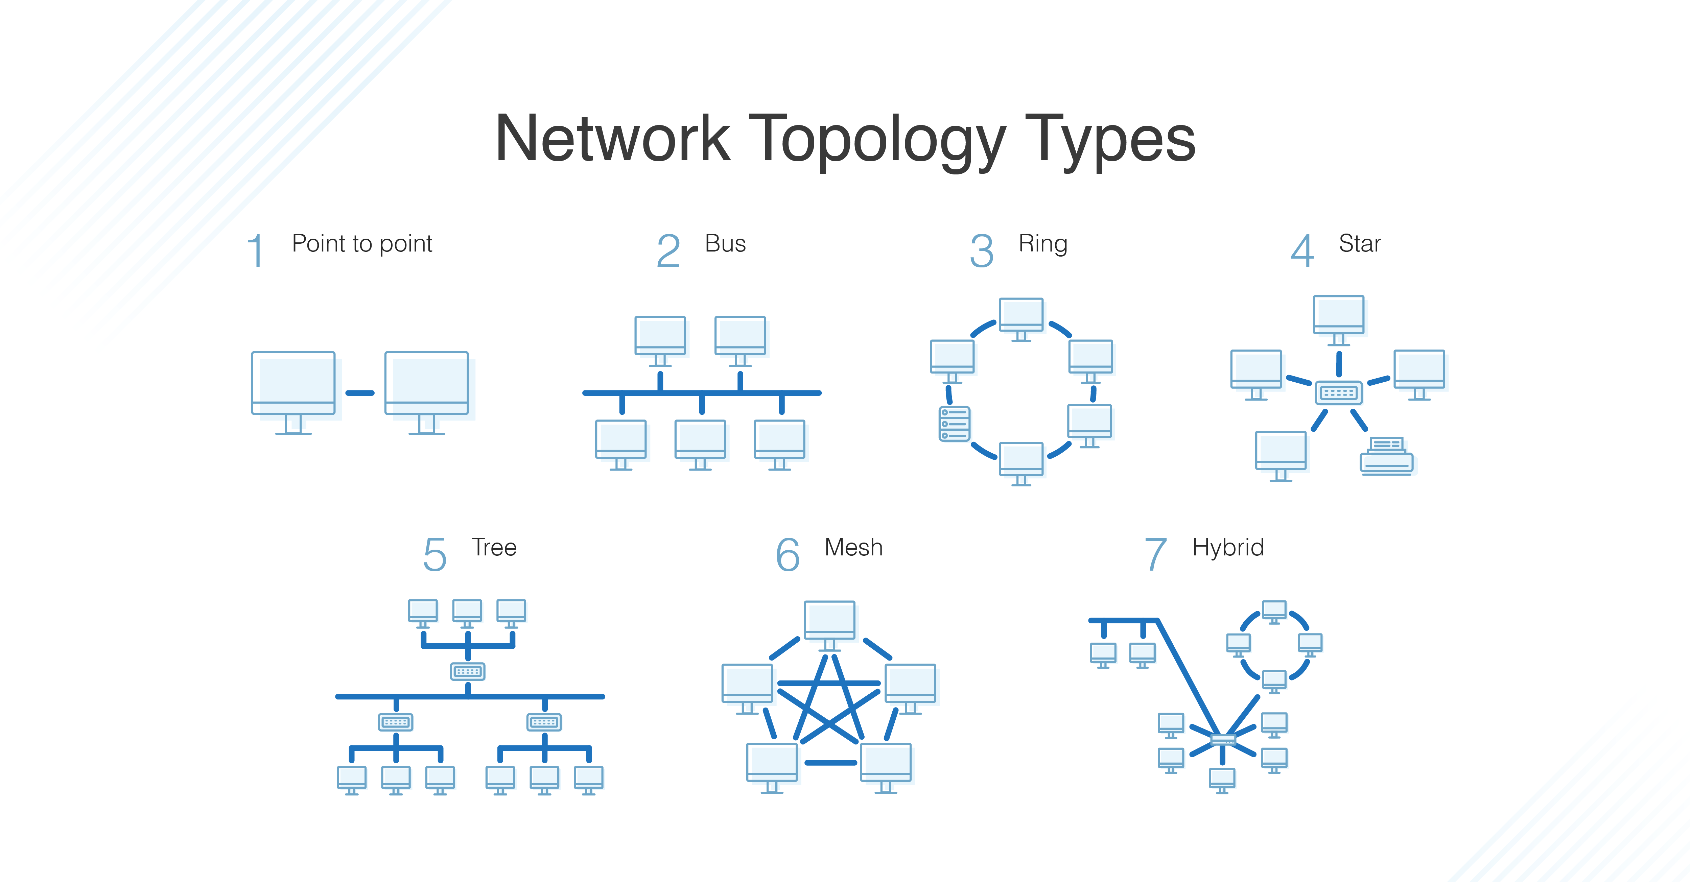



What is Network Topologies

Slide 7
Agenda
What is Network Topologies
What is Internet and Web Servers
HTTP Request/Response Cycle
HTML
CSS
Scrapping Concept
BeautifulSoap Library
REST API Web Services
Work with JSON

Slide 8
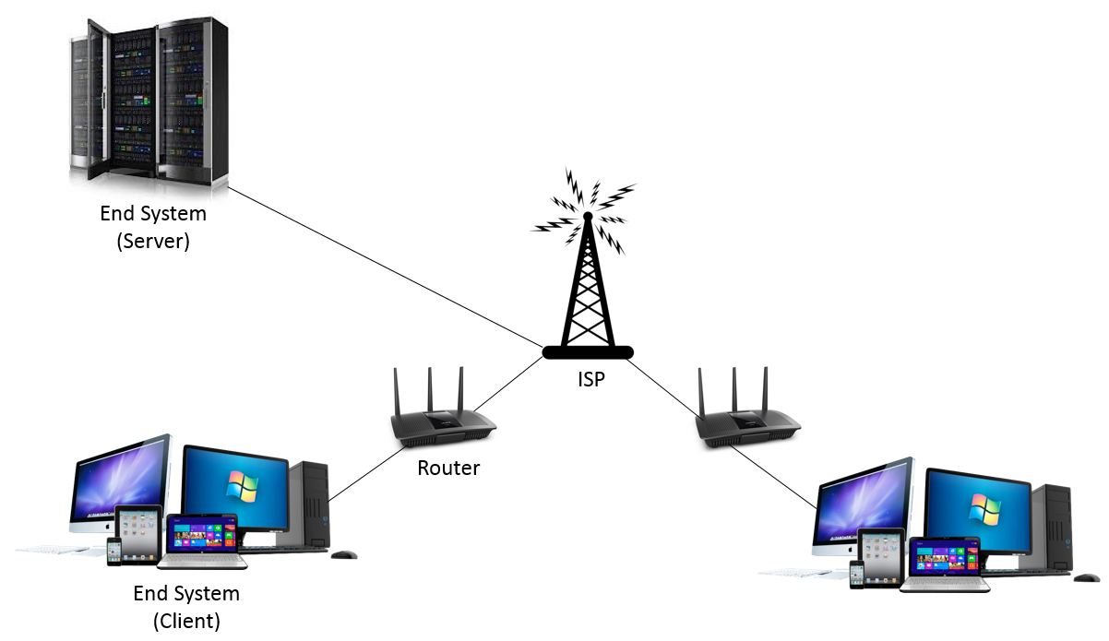
What is Internet and Web Servers

Slide 9
Agenda
What is Network Topologies
What is Internet and Web Servers
HTTP Request/Response Cycle
HTML
CSS
Scrapping Concept
BeautifulSoap Library
REST API Web Services
Work with JSON

Slide 10
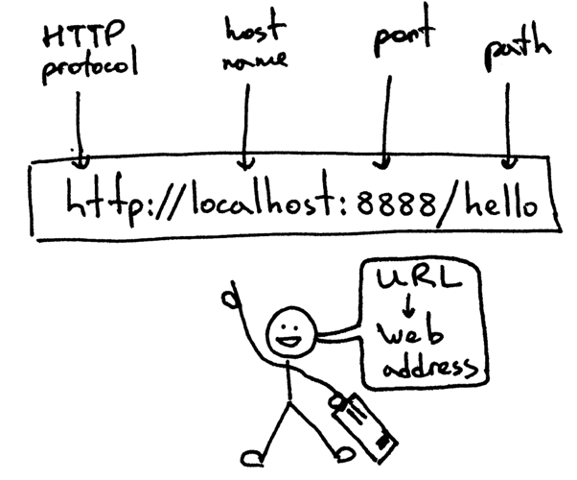
HTTP Request/Response Cycle

Slide 11
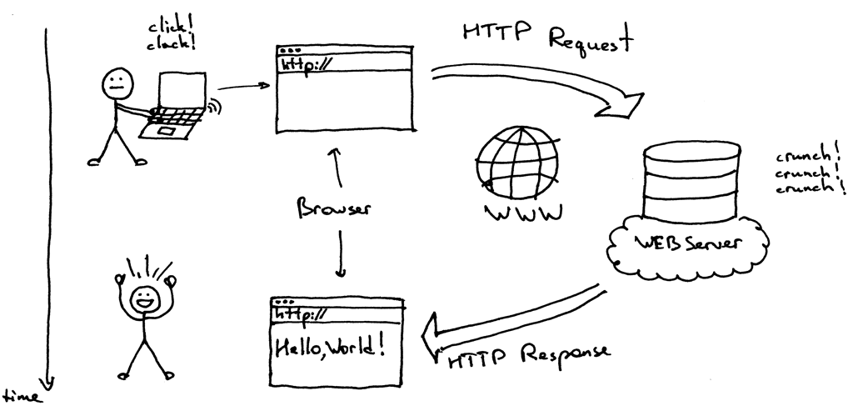
HTTP Request/Response Cycle

Slide 12
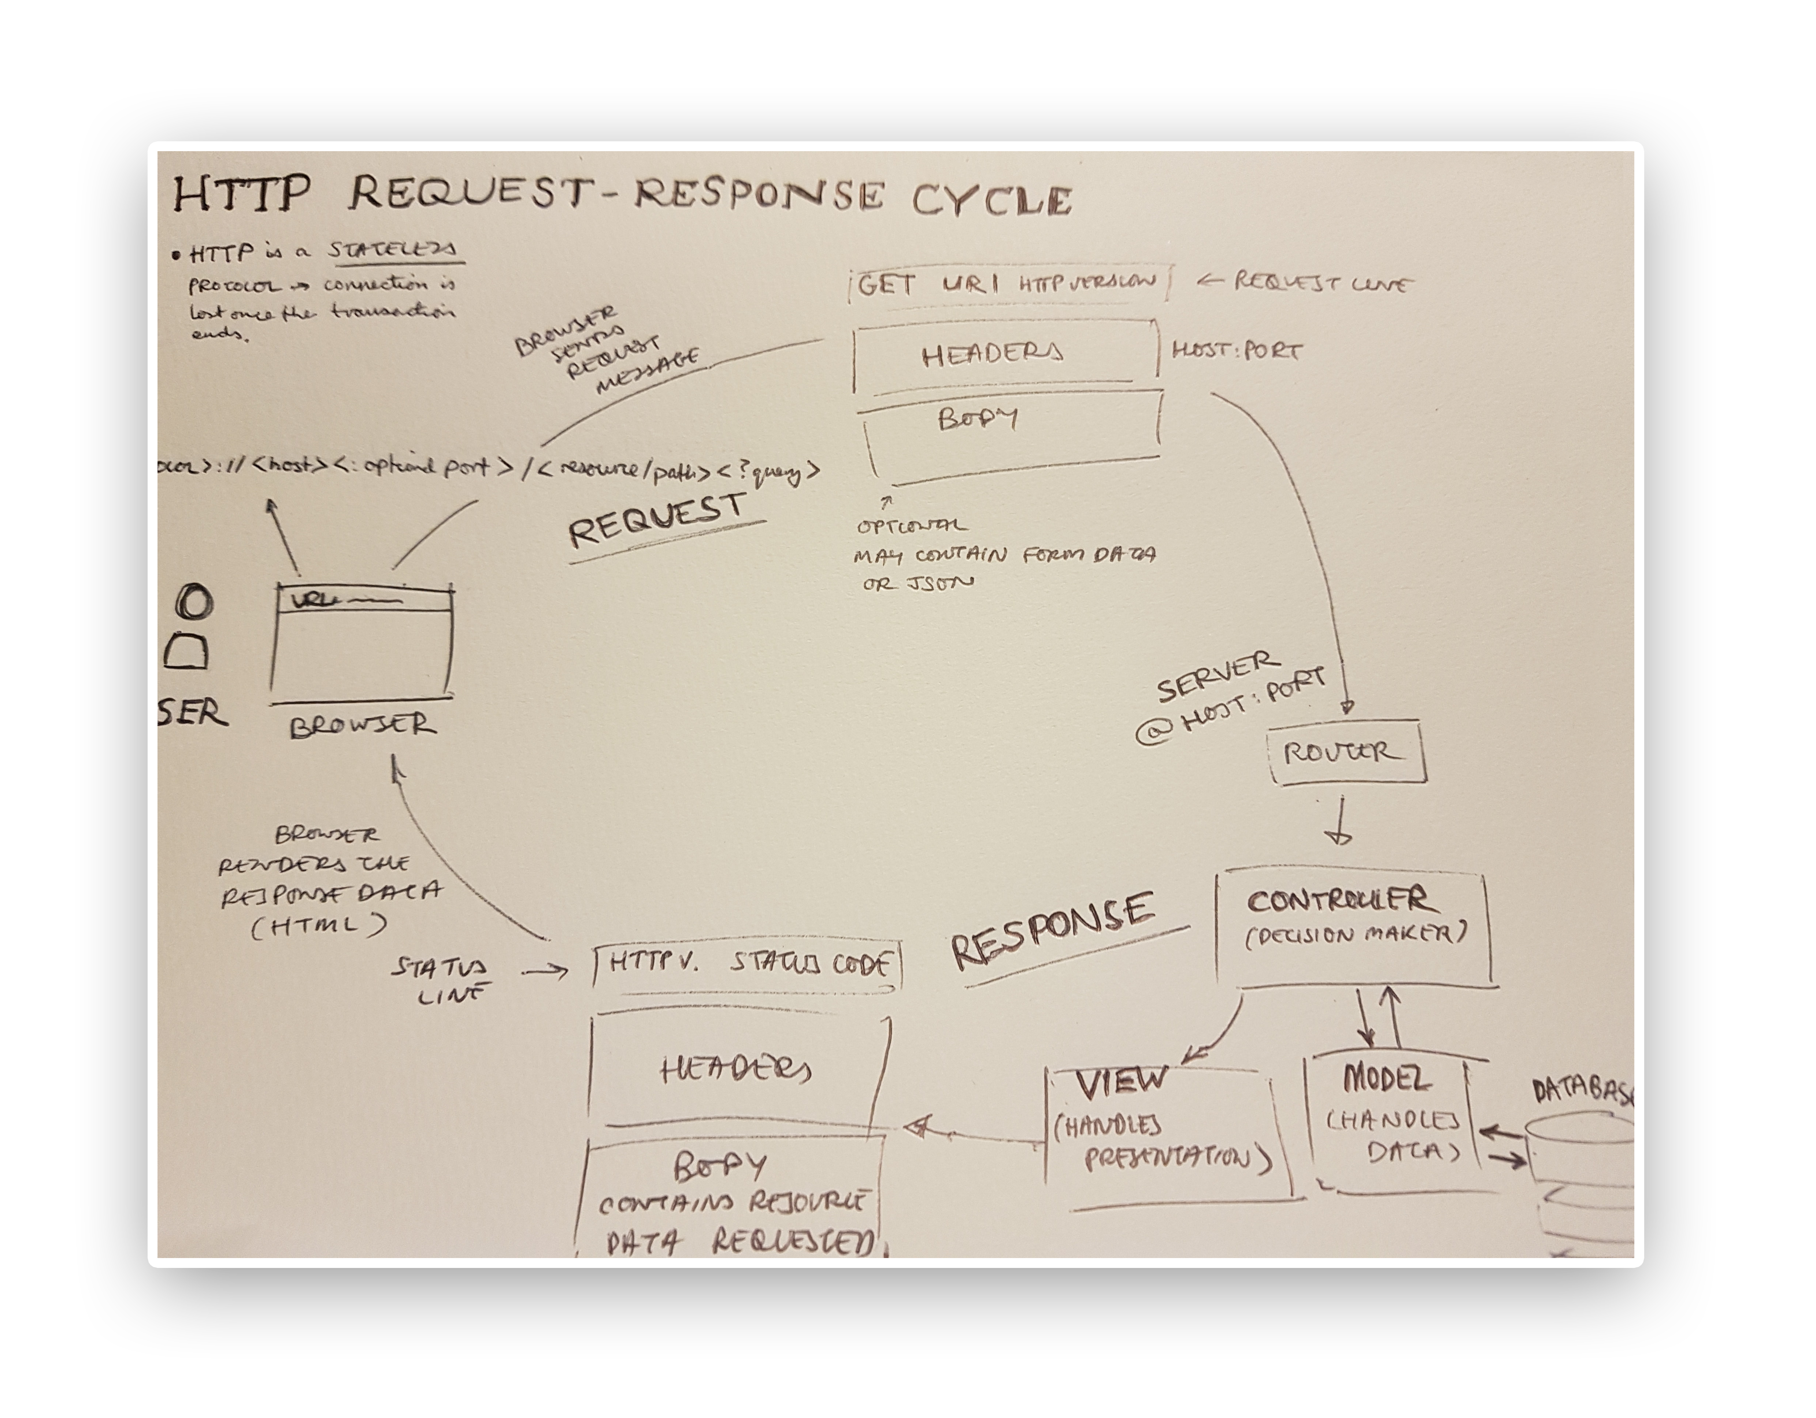

Slide 13
Agenda
What is Network Topologies
What is Internet and Web Servers
HTTP Request/Response Cycle
HTML
CSS
Scrapping Concept
BeautifulSoap Library
REST API Web Services
Work with JSON

Slide 14
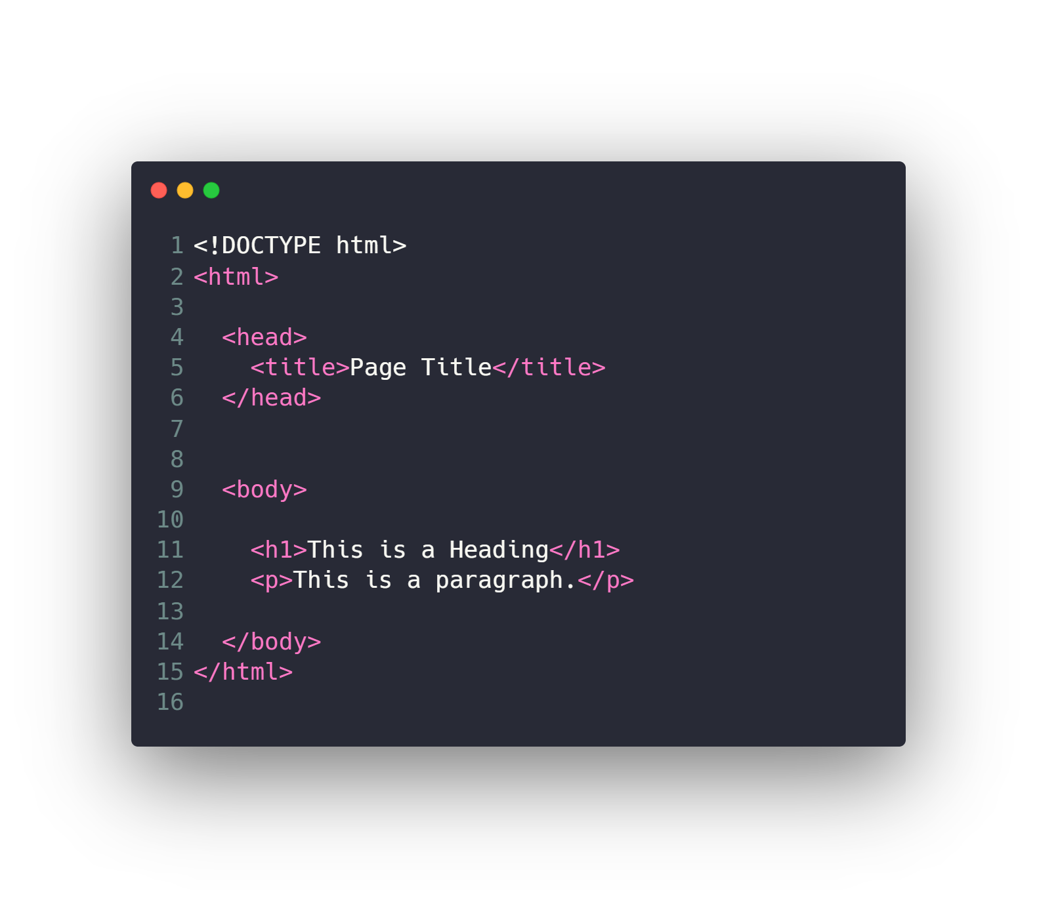
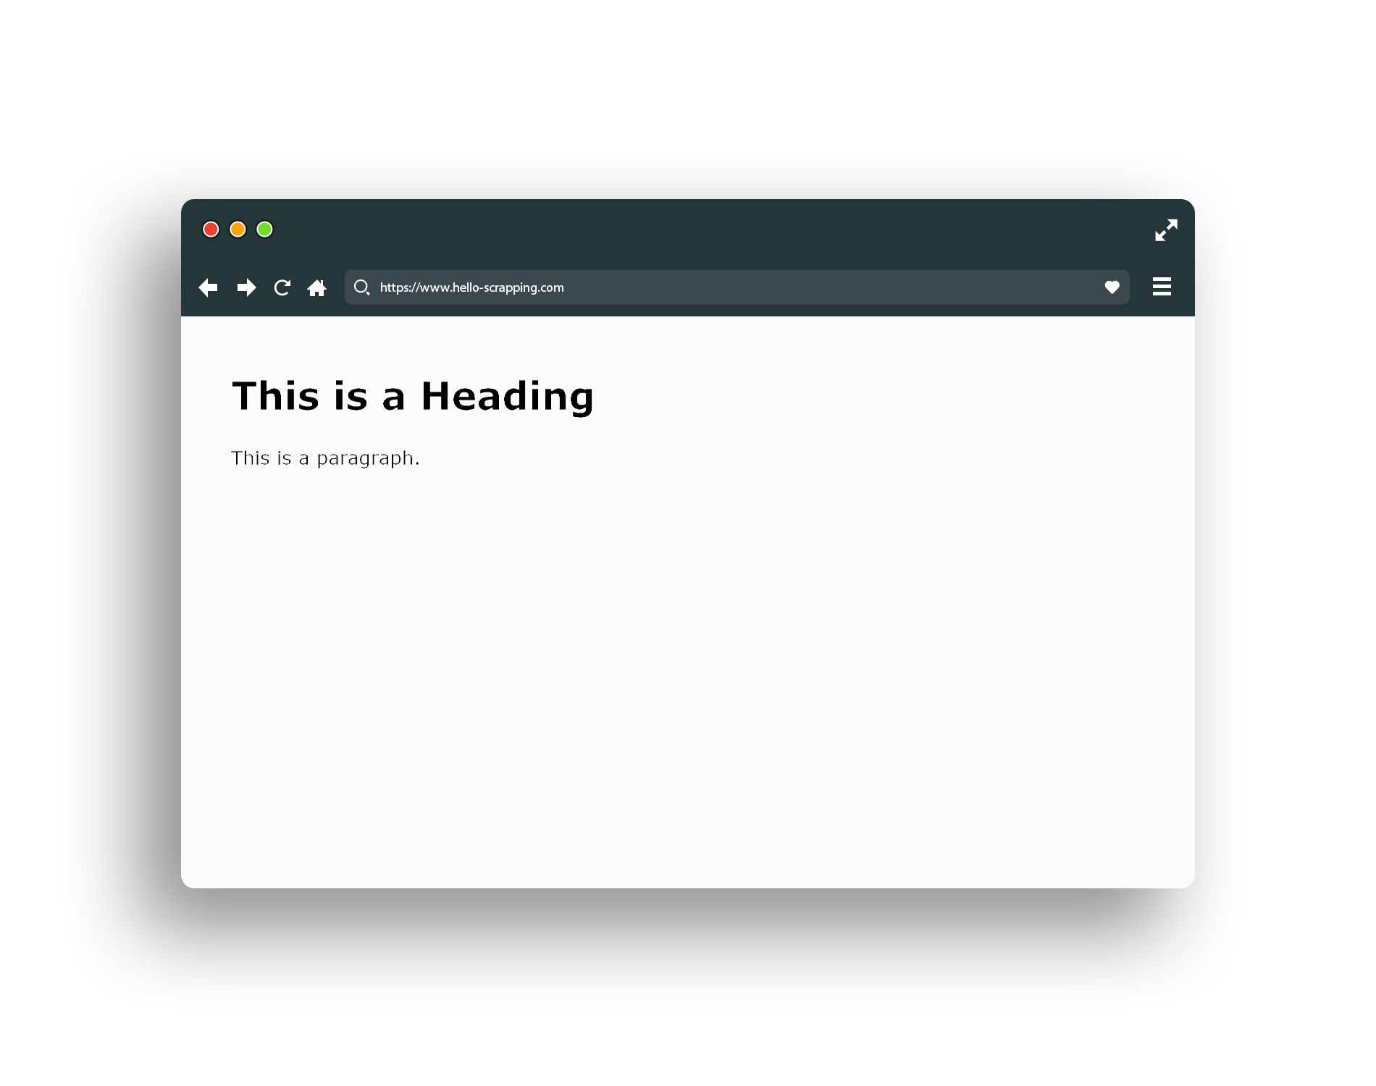
HTML (base snippet code)

Slide 15
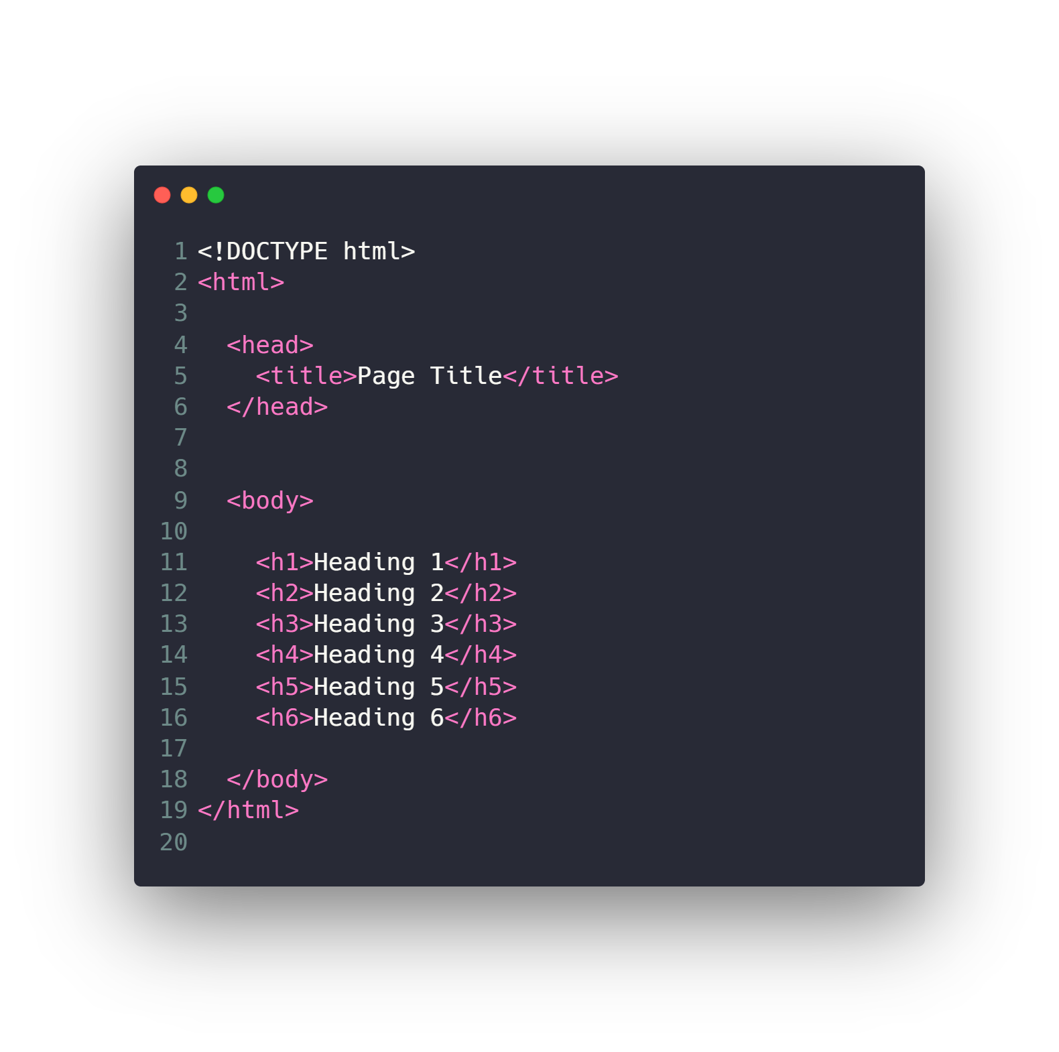
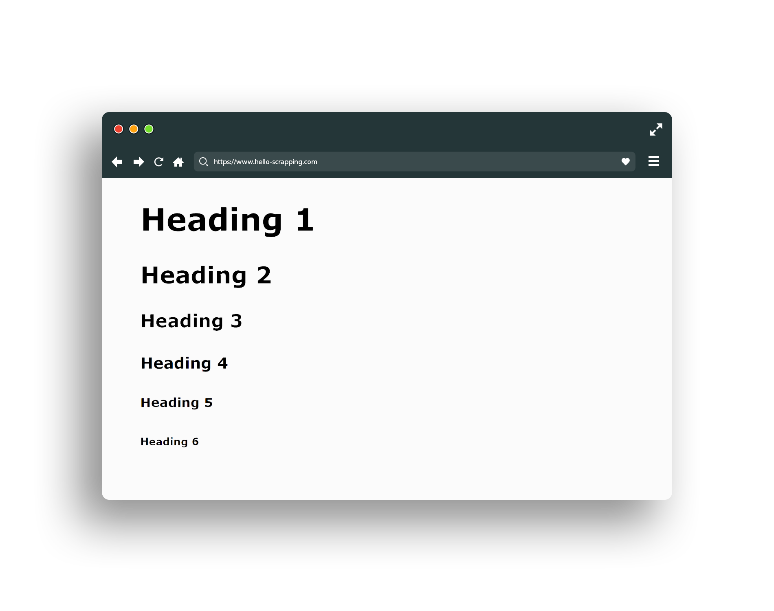
HTML (header)

Slide 16
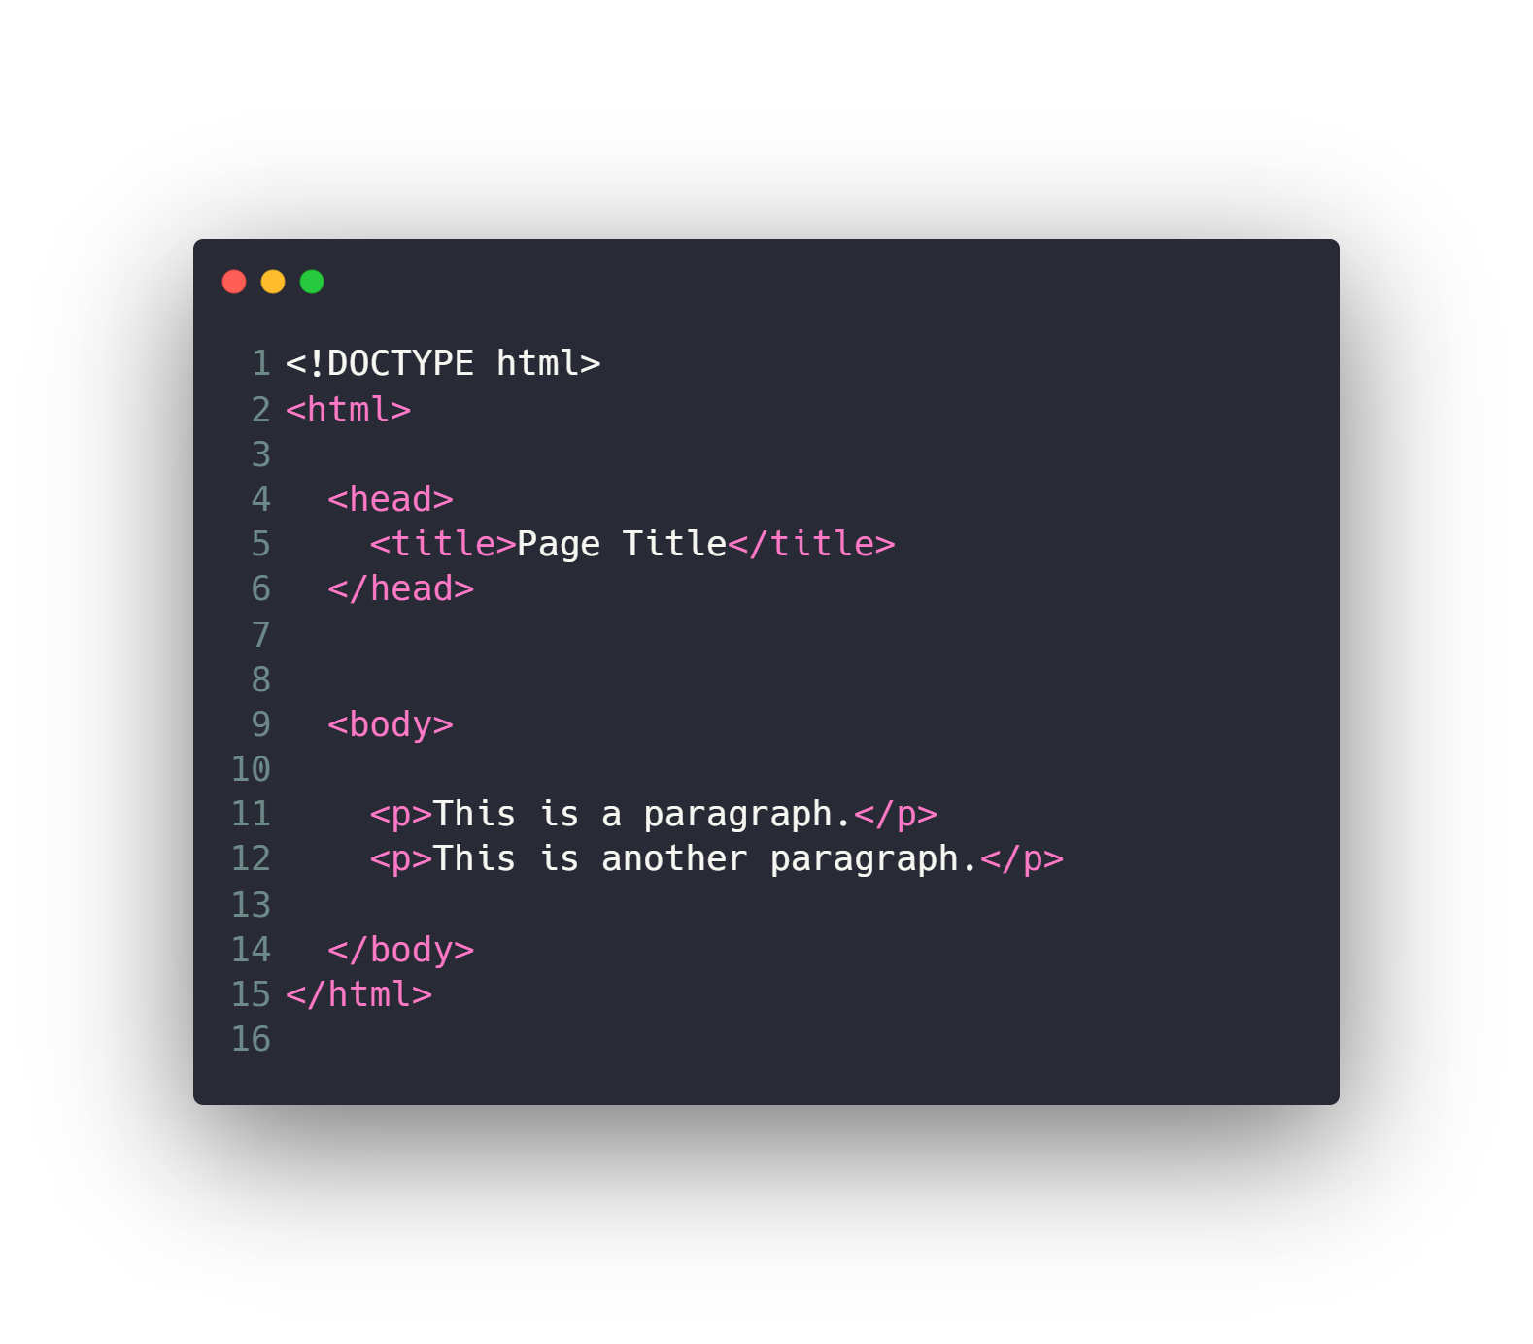
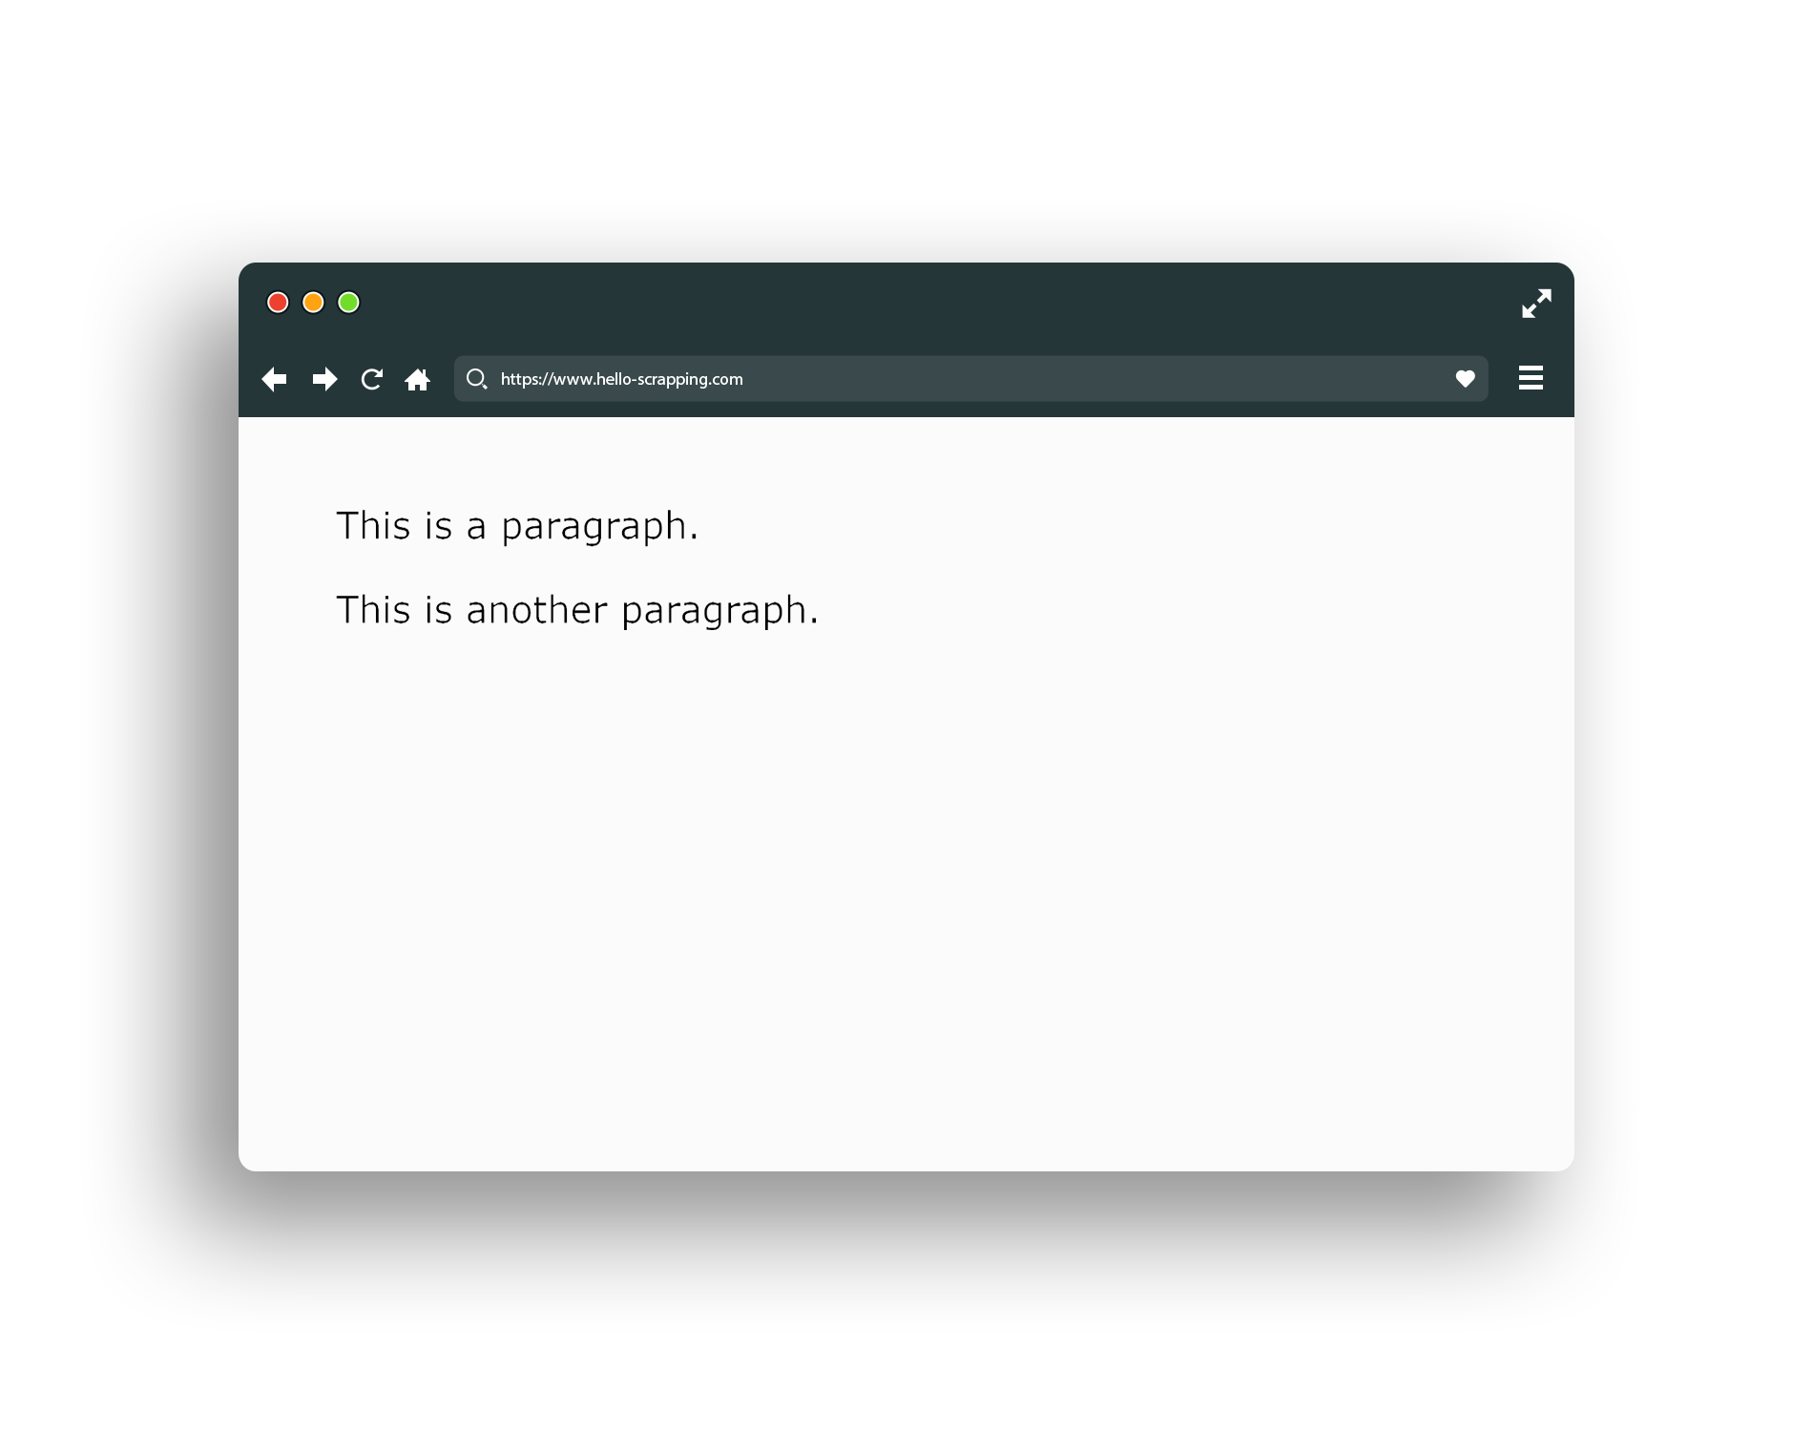
HTML (paragraph)

Slide 17
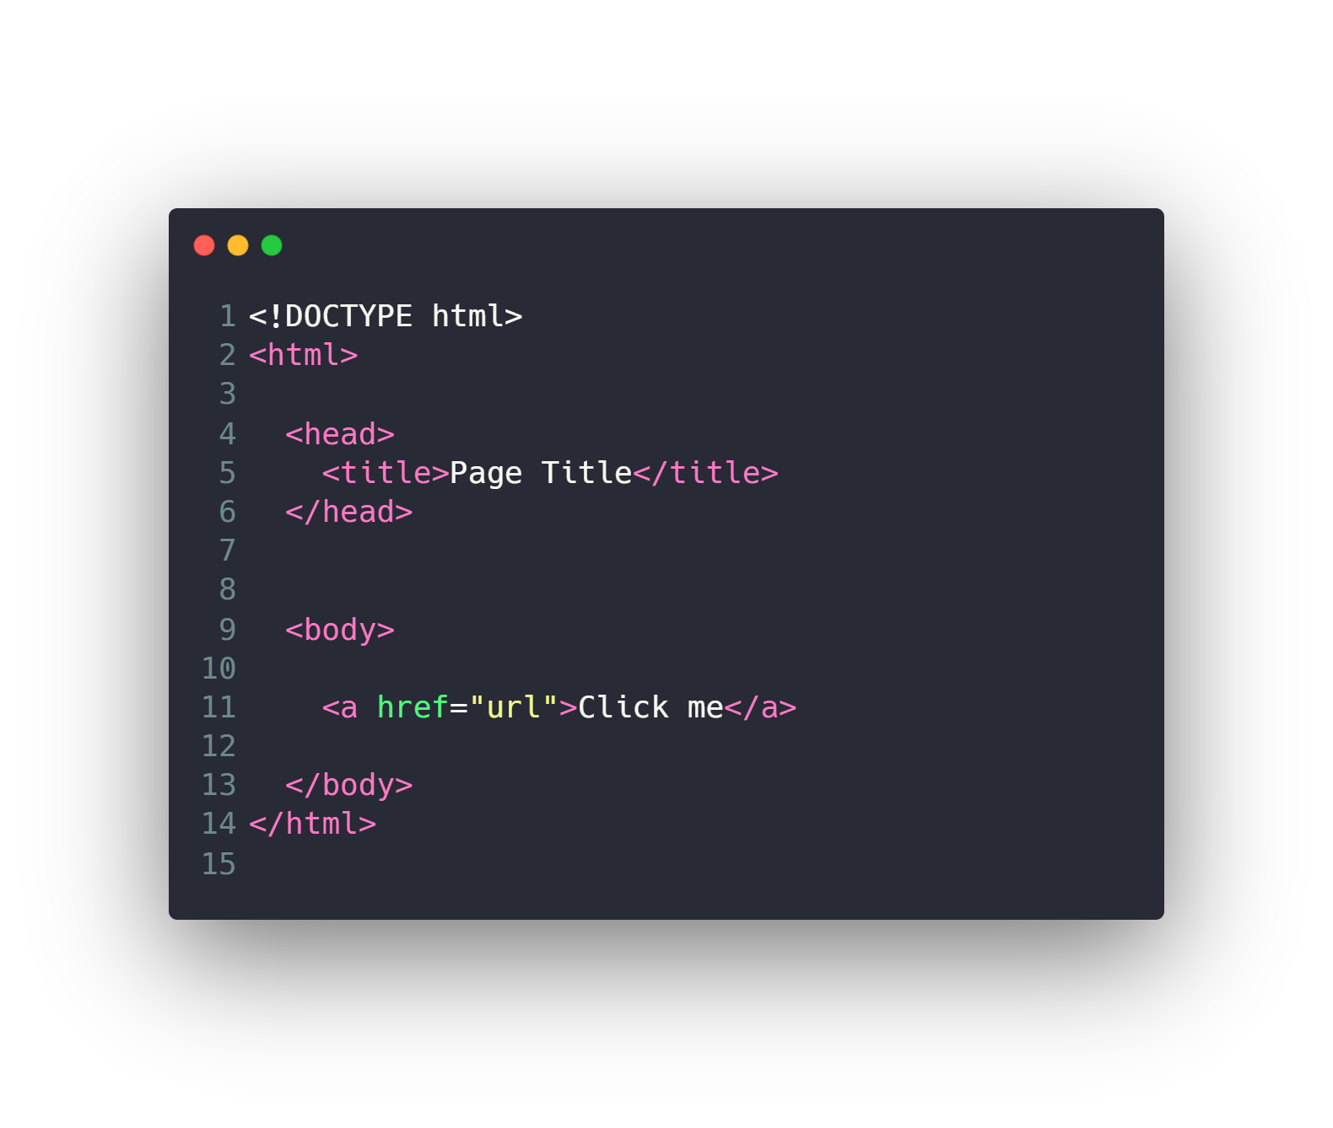
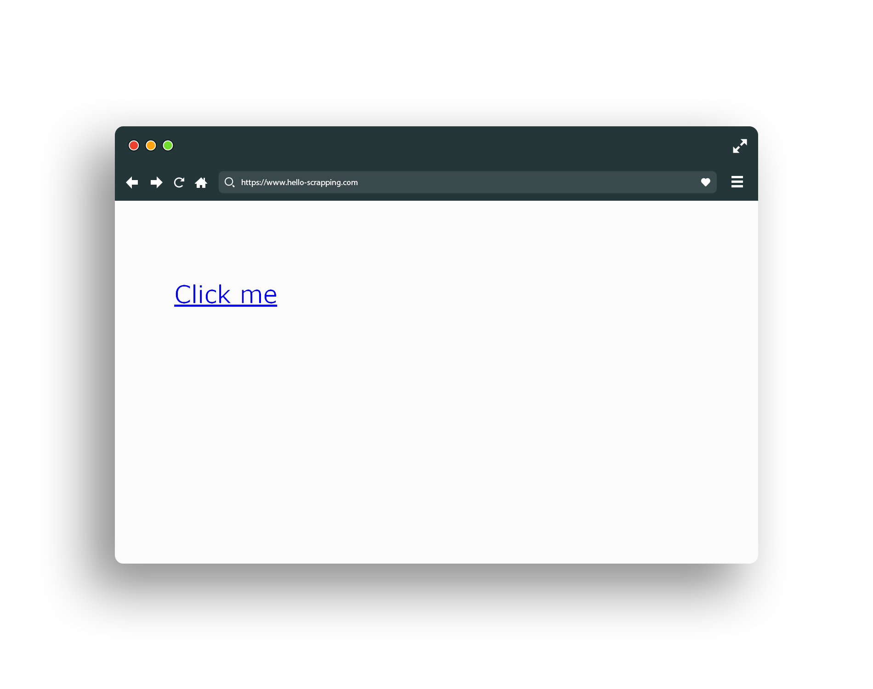
HTML (link)

Slide 18
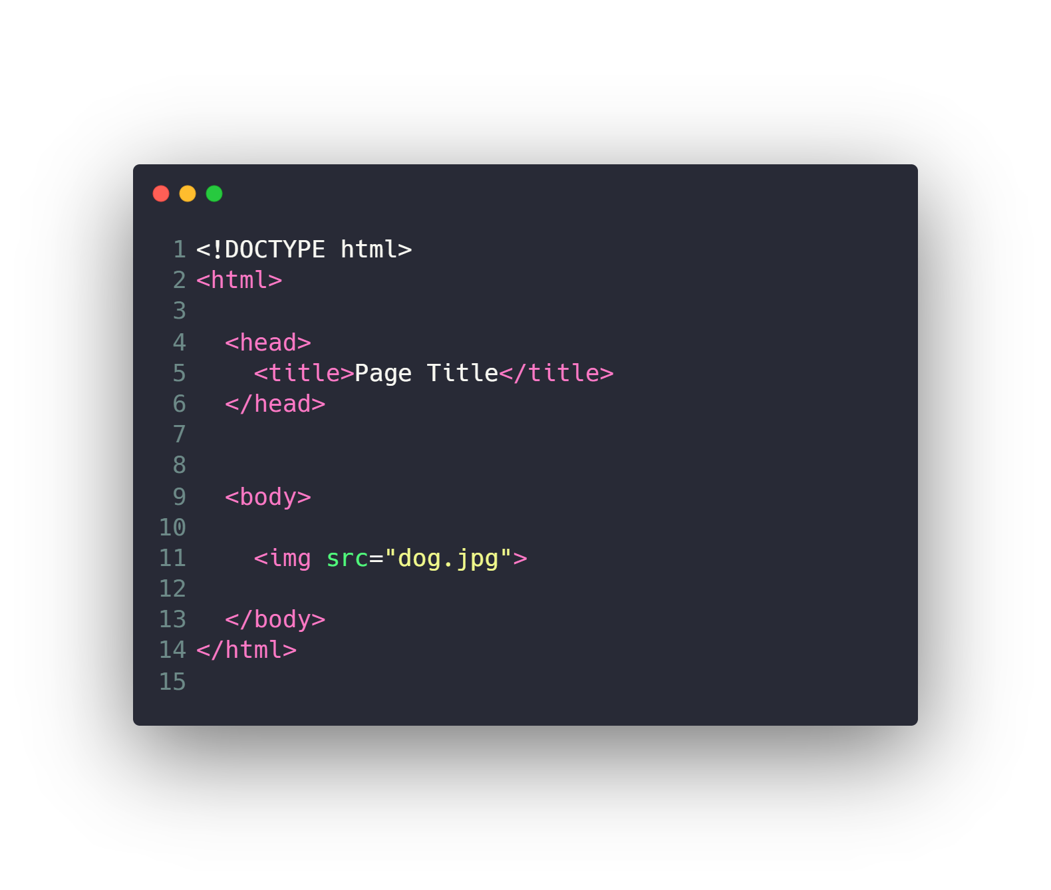
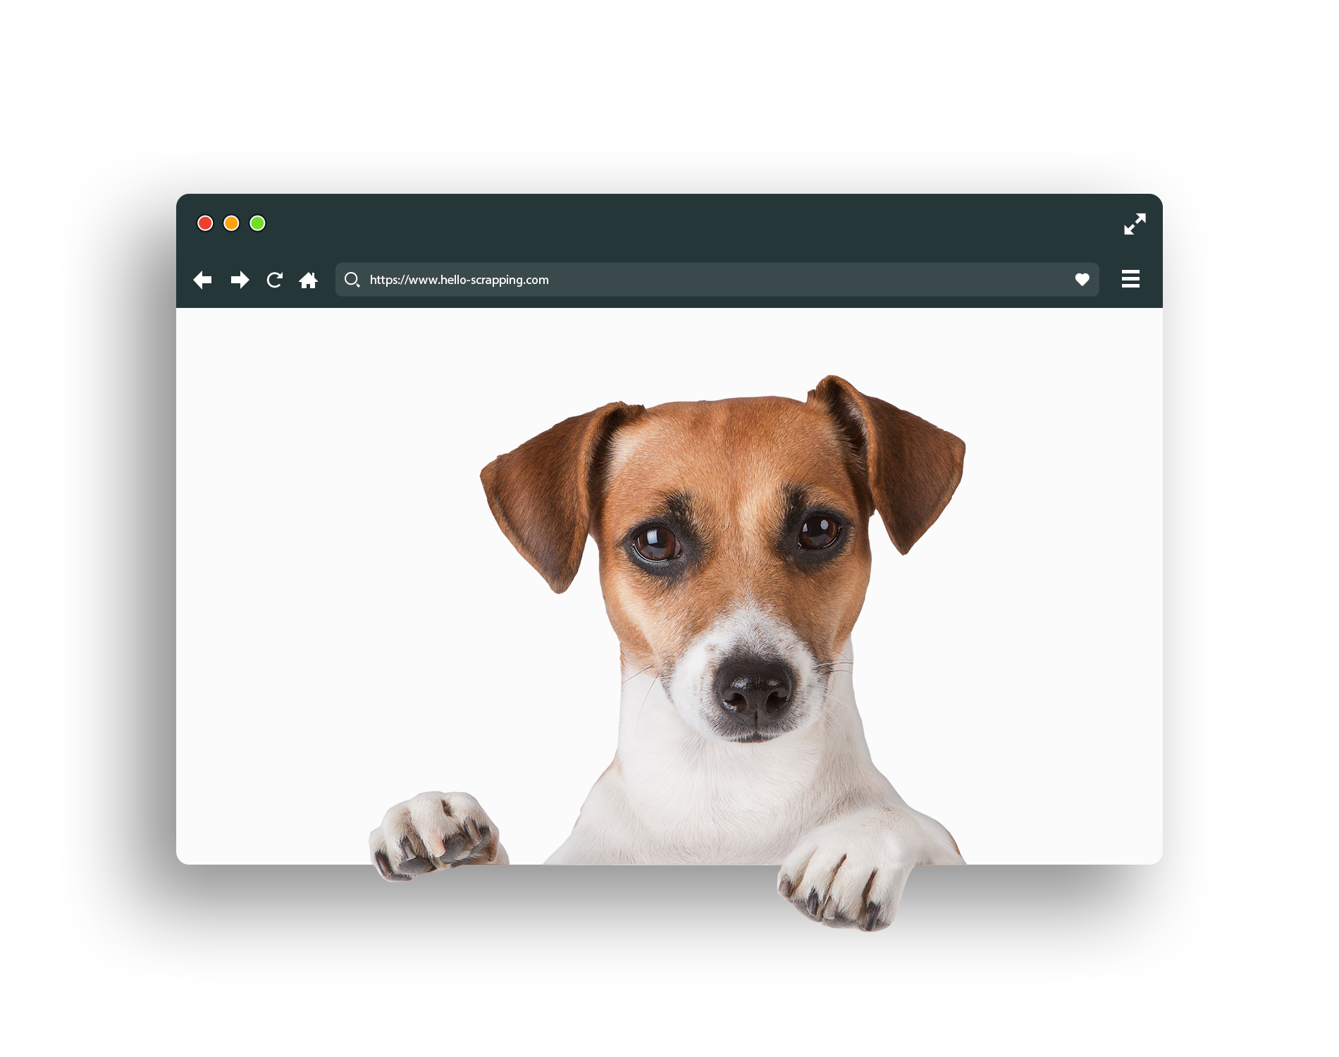
HTML (image)

Slide 19
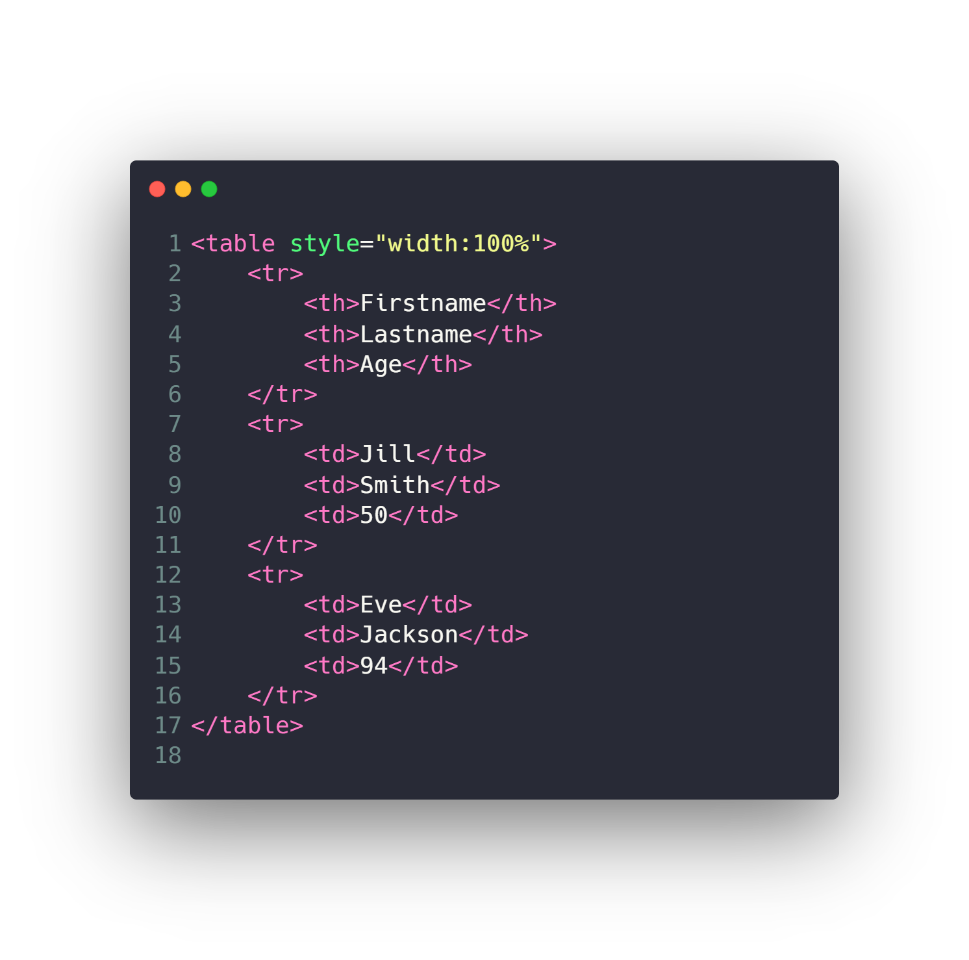
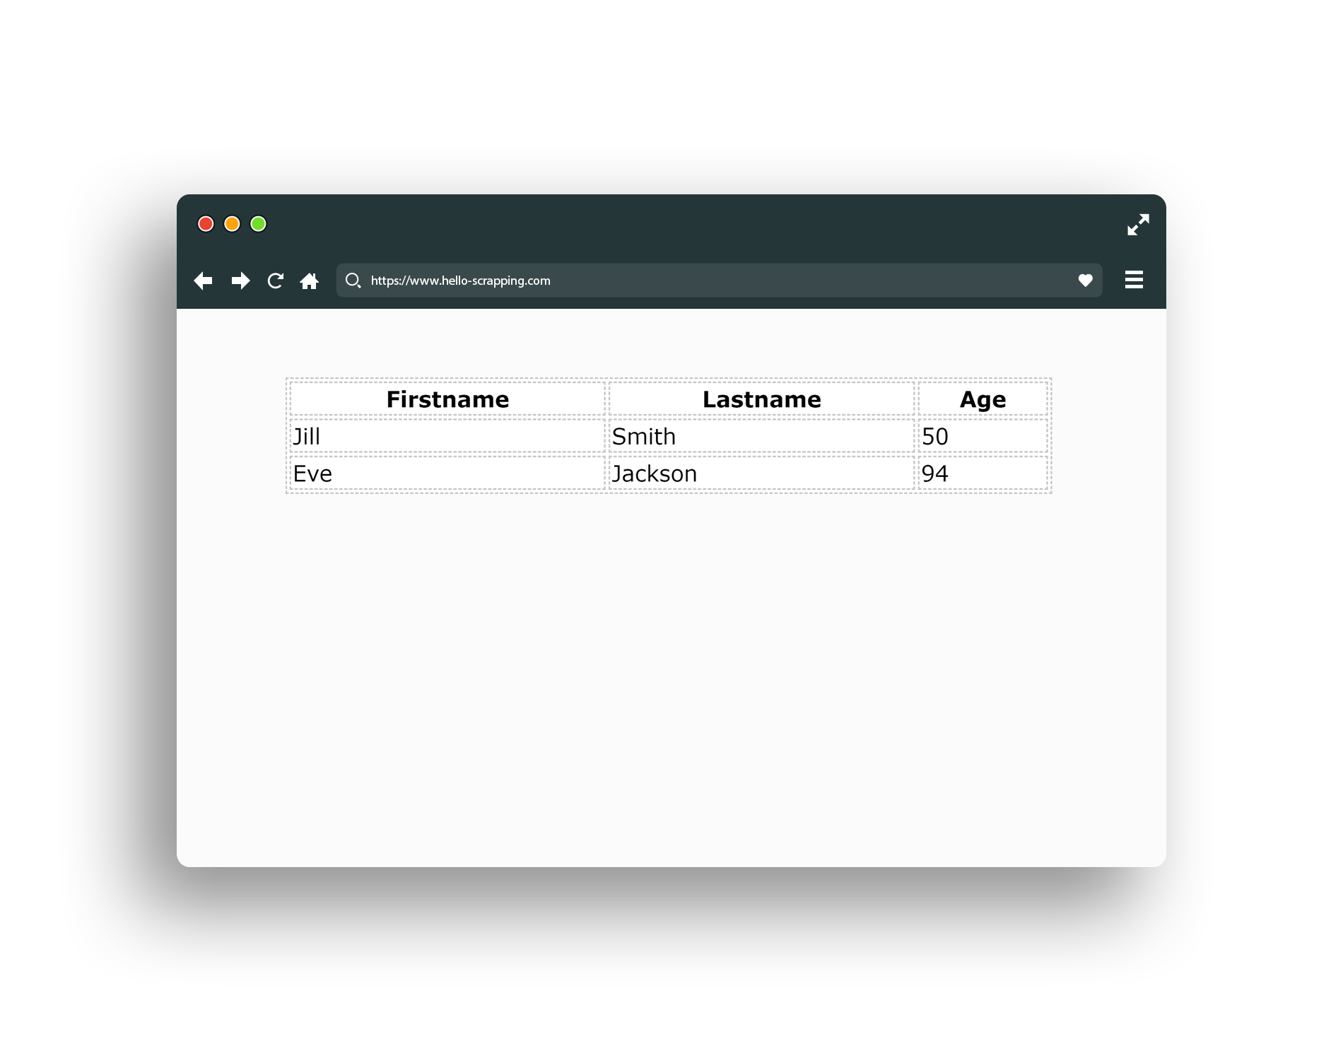
HTML (table)

Slide 20
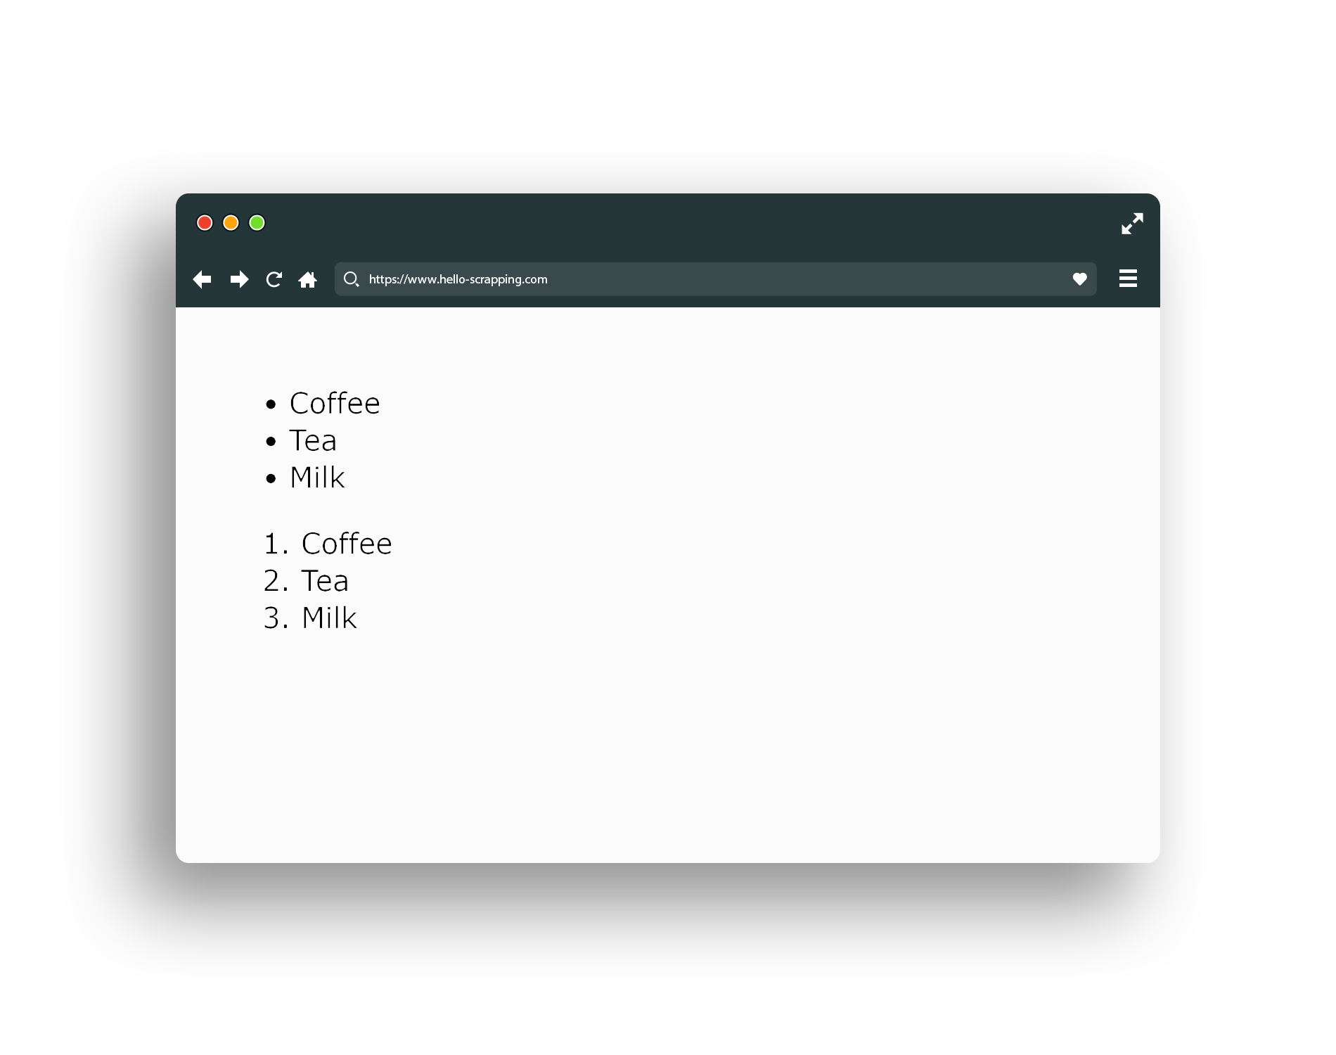
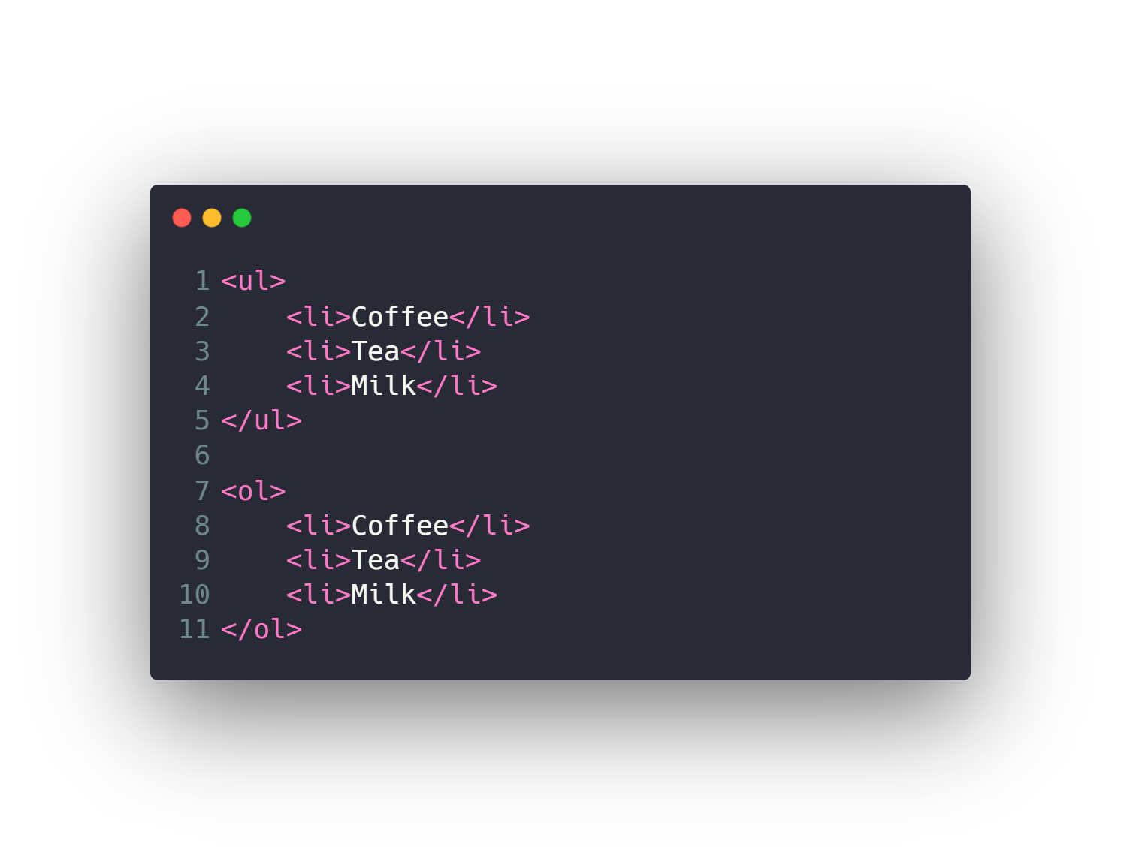
HTML (list)

Slide 21
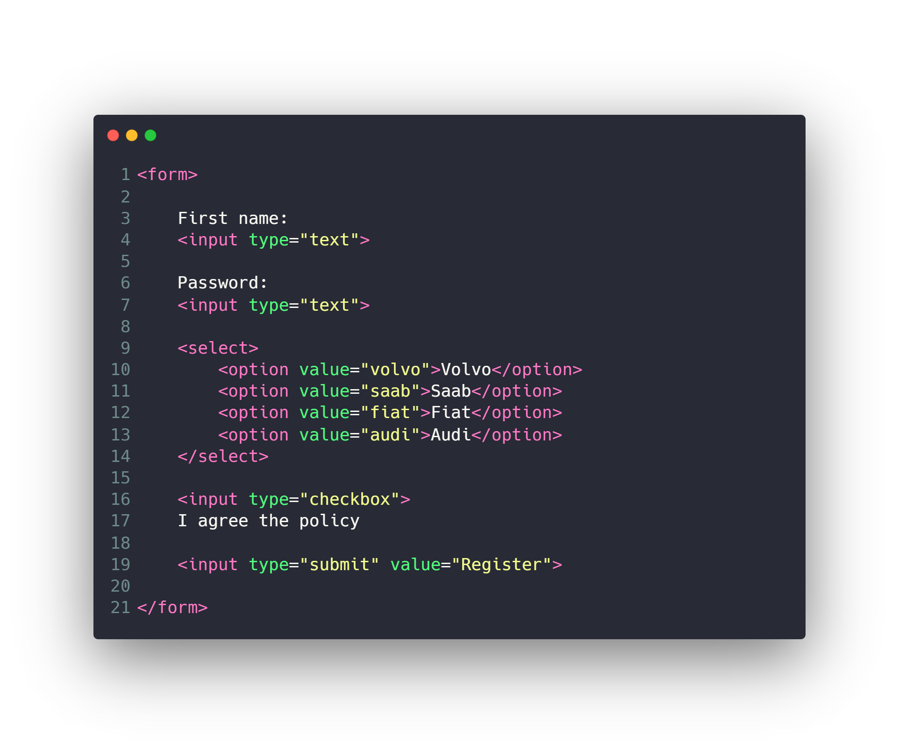
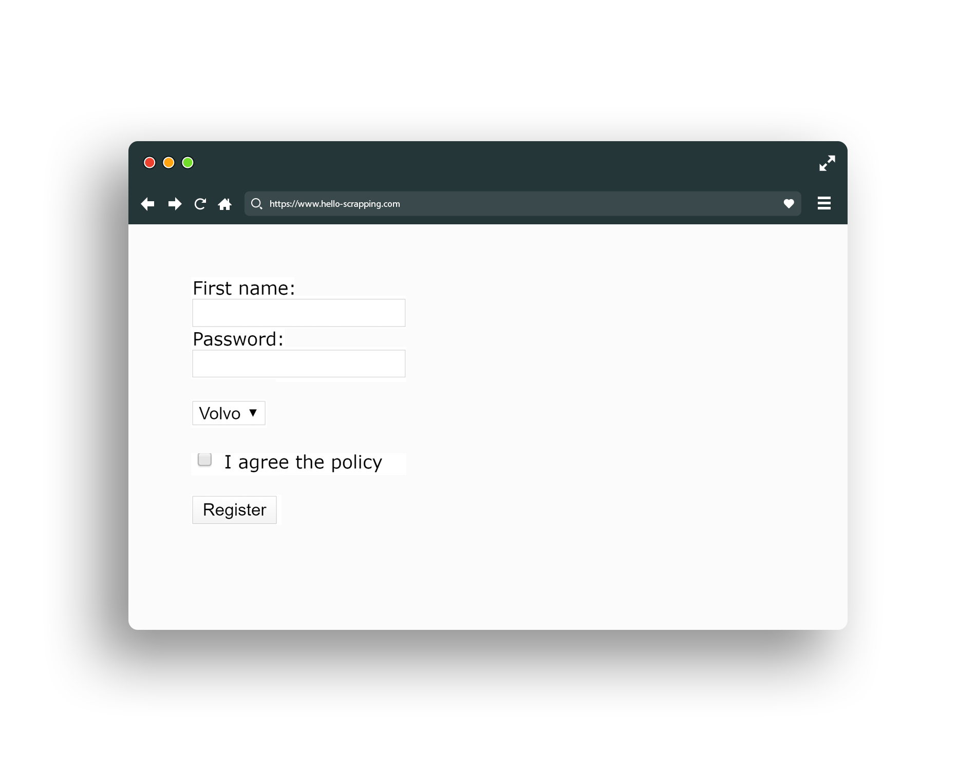
HTML (form)

Slide 22
Other HTML Elements
Div
Span
Video
Audio
Iframe
Header
Footer
Canvas
…

Slide 23
Agenda
What is Network Topologies
What is Internet and Web Servers
HTTP Request/Response Cycle
HTML
CSS
Scrapping Concept
BeautifulSoap Library
REST API Web Services
Work with JSON

Slide 24
CSS
Text & Fonts
Colors
Backgrounds
Borders
Margin & Padding
Width & Height
Gradient
Shadows
…

Slide 25
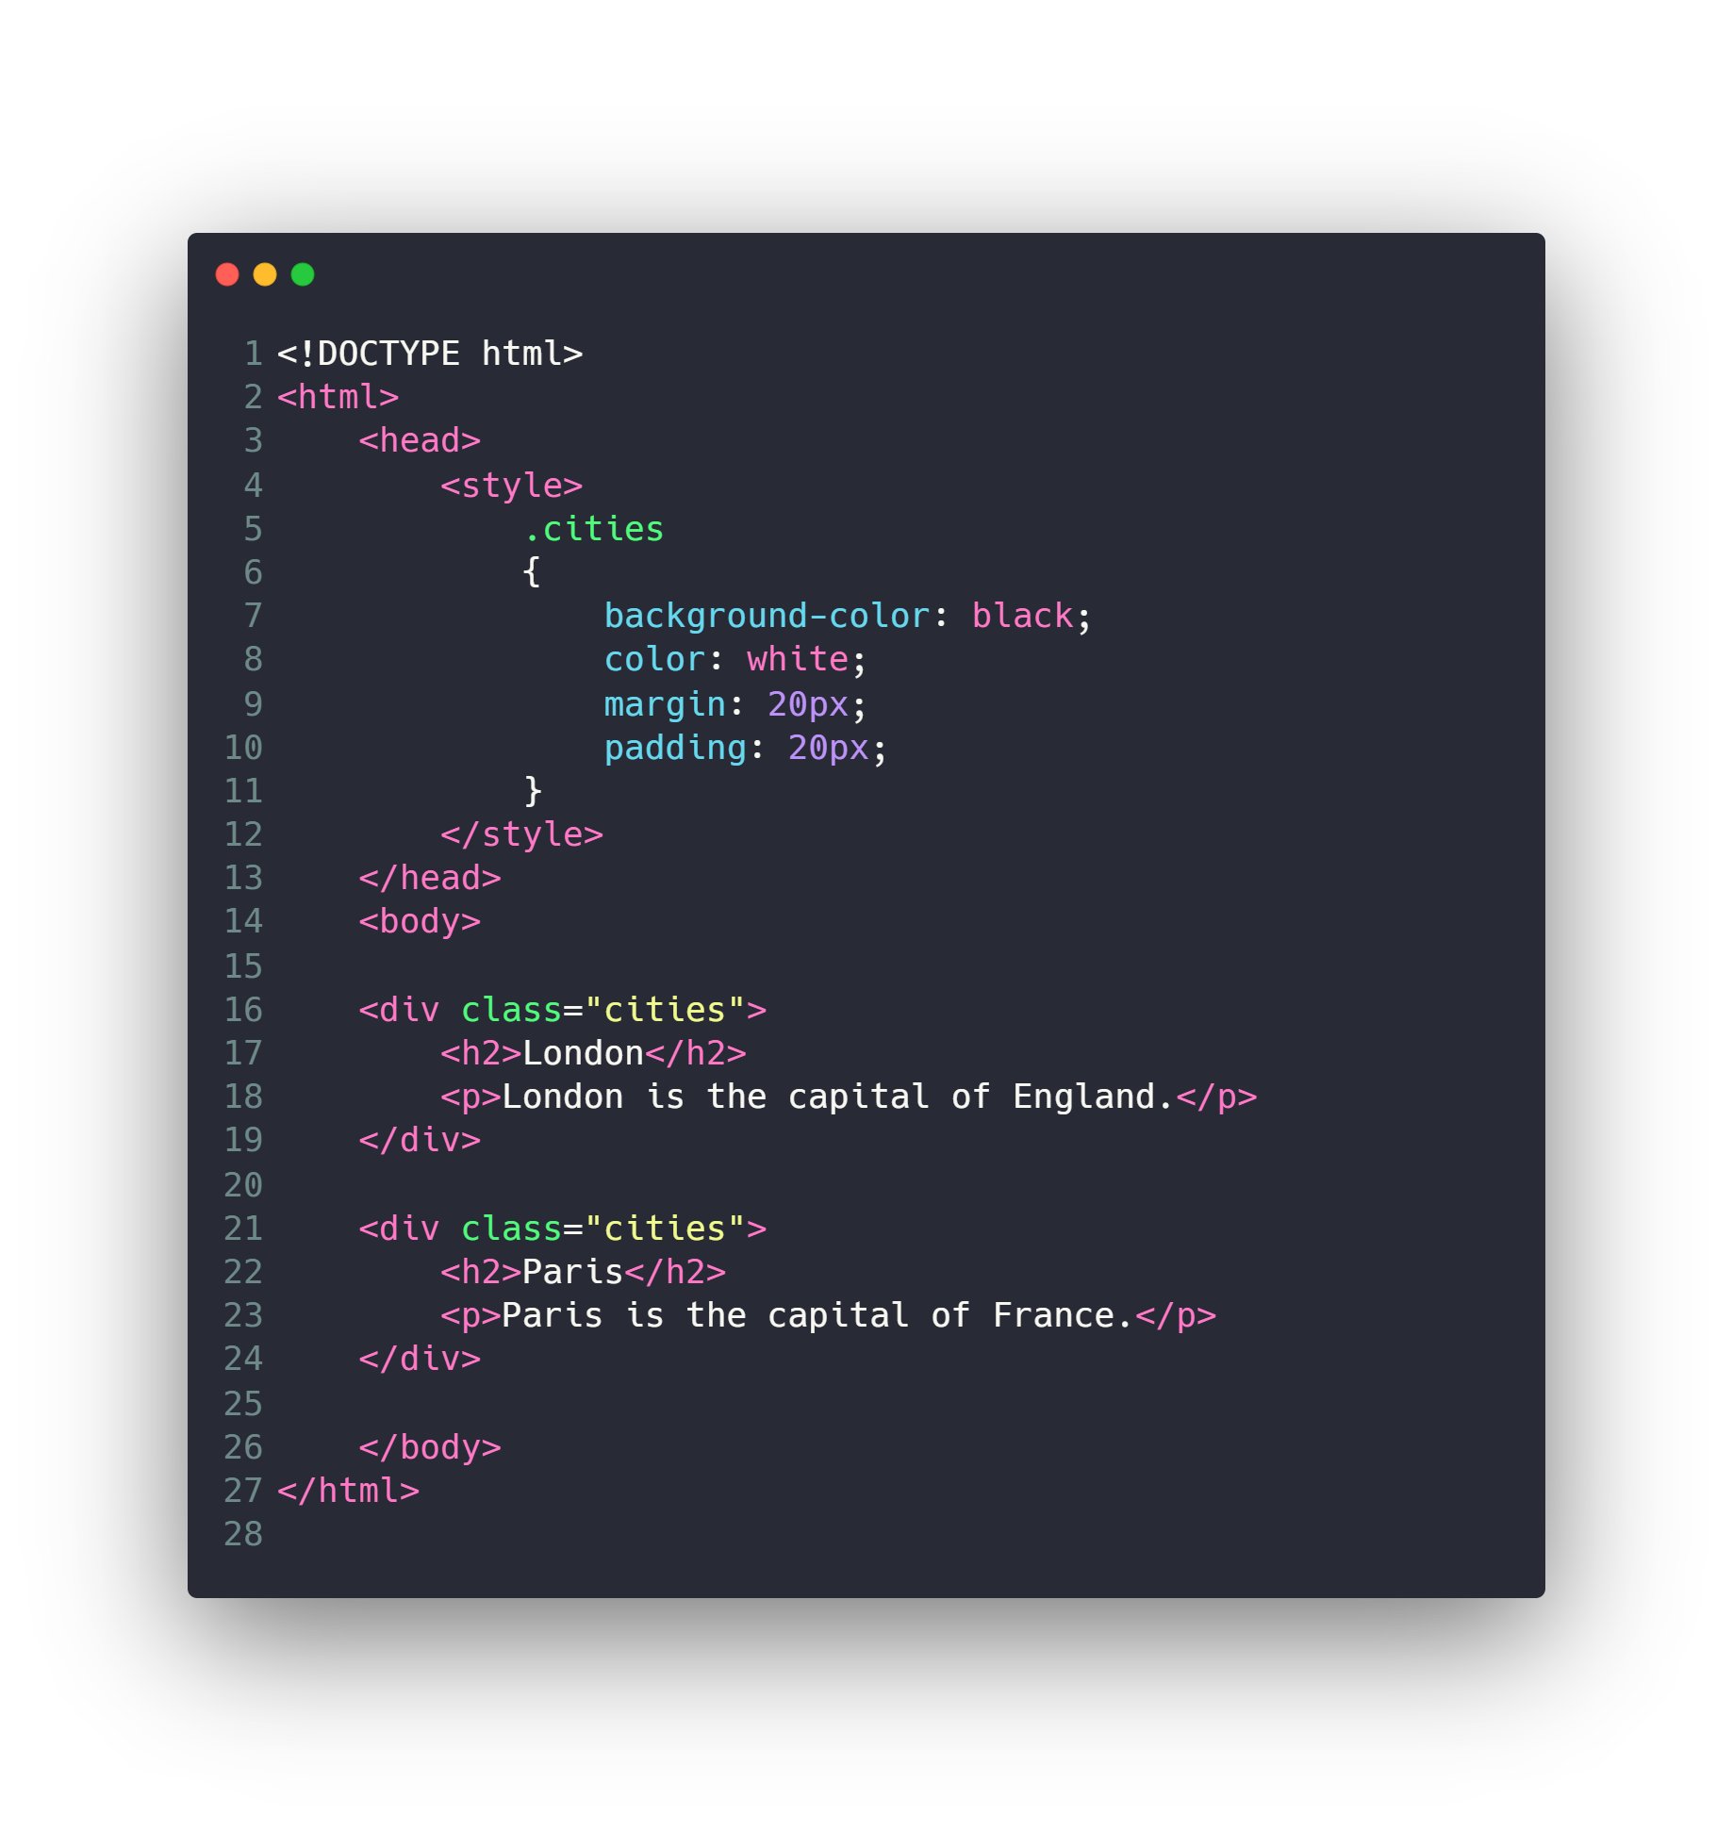
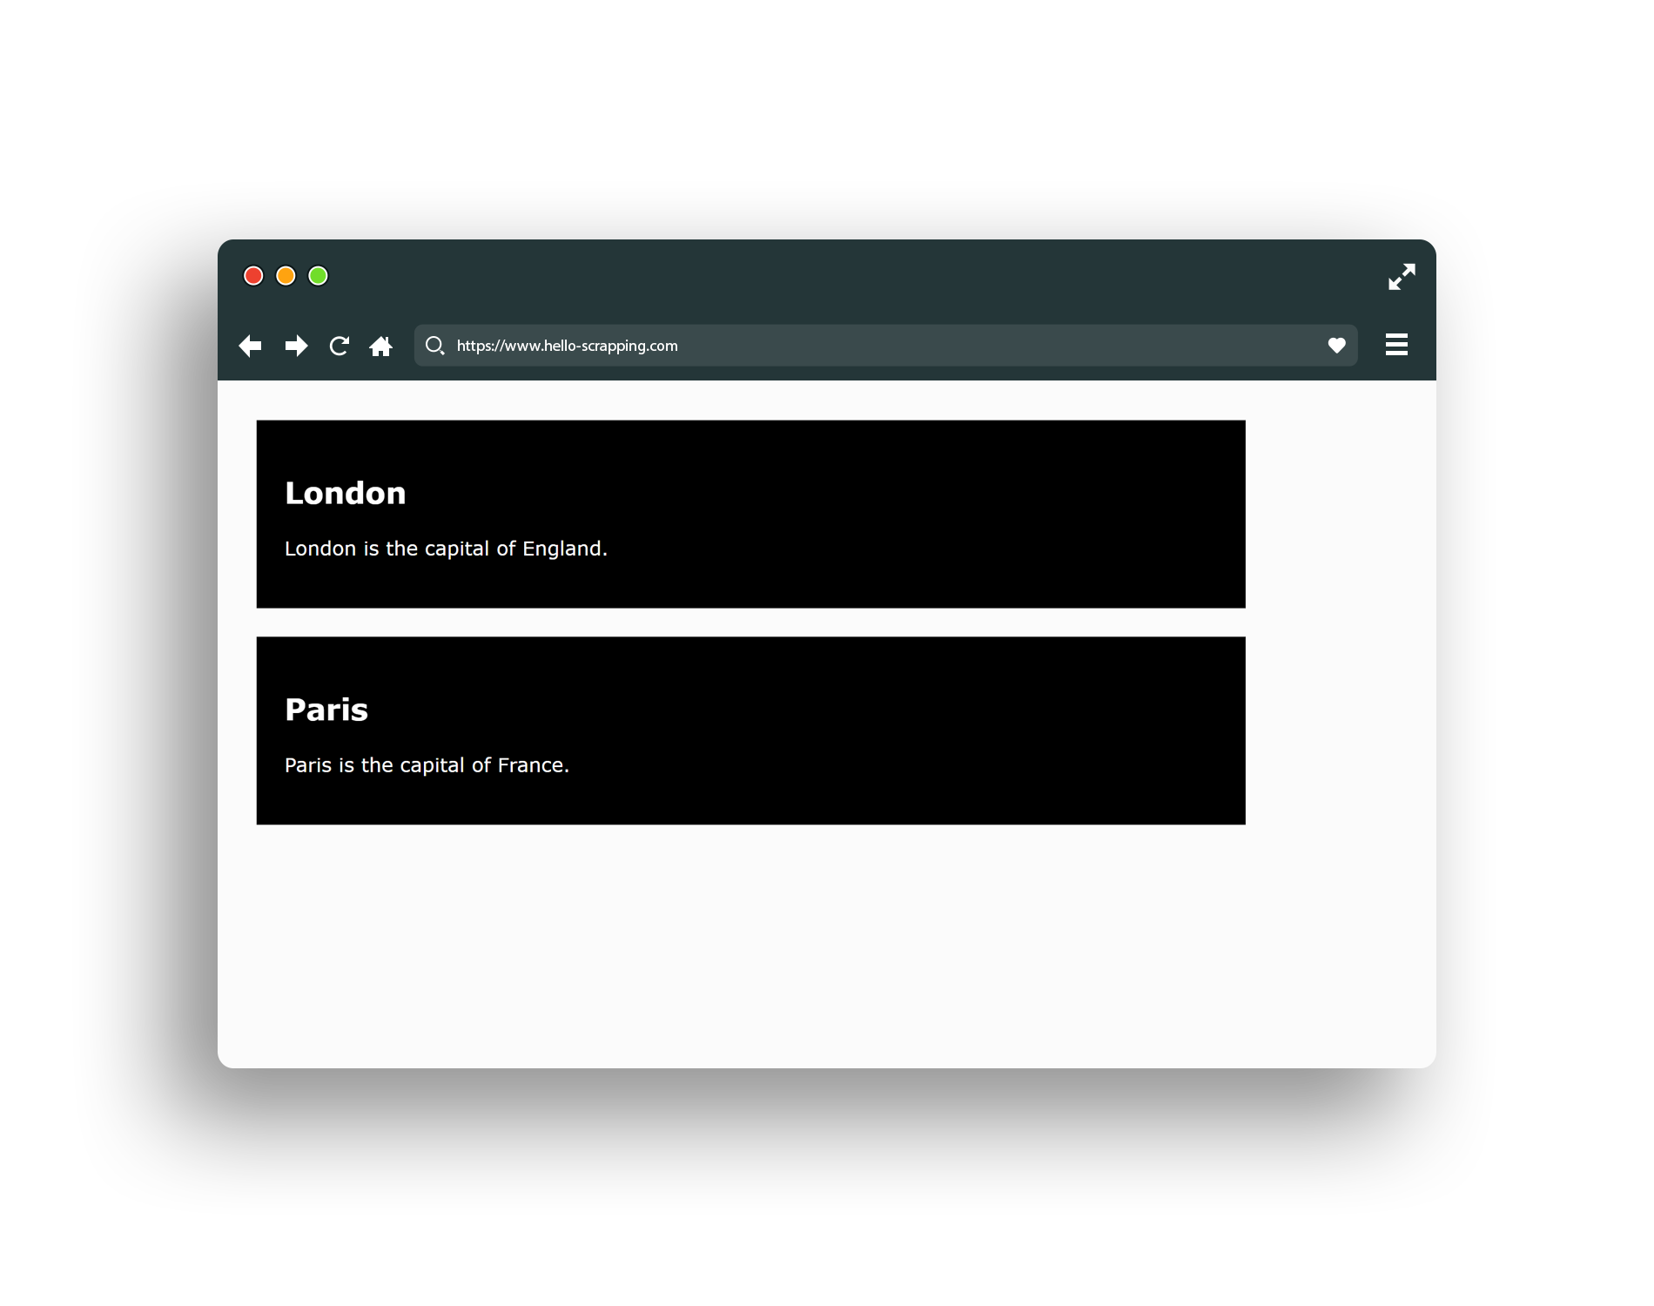
Classes and ID

Slide 26

Check Also
JavaScript
React & Angular
Ajax
Web Sockets
PHP: Laravel
Python: Flask, Django
JavaScript: Node.js
…

Slide 27
Agenda
What is Network Topologies
What is Internet and Web Servers
HTTP Request/Response Cycle
HTML
CSS
Scrapping Concept
BeautifulSoap Library
REST API Web Services
Work with JSON

Slide 28

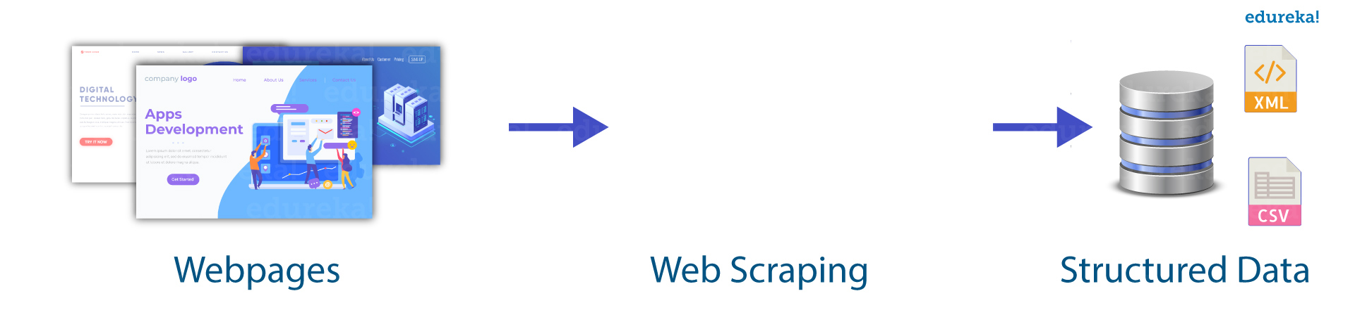
Scrapping Concept

Slide 29
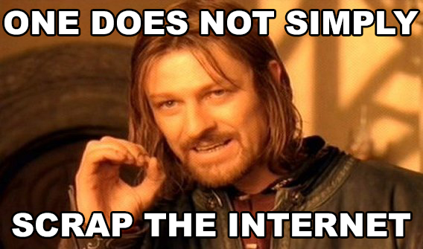
Scrapping Concept

Slide 30
Agenda
What is Network Topologies
What is Internet and Web Servers
HTTP Request/Response Cycle
HTML
CSS
Scrapping Concept
BeautifulSoap Library
REST API Web Services
Work with JSON

Slide 31
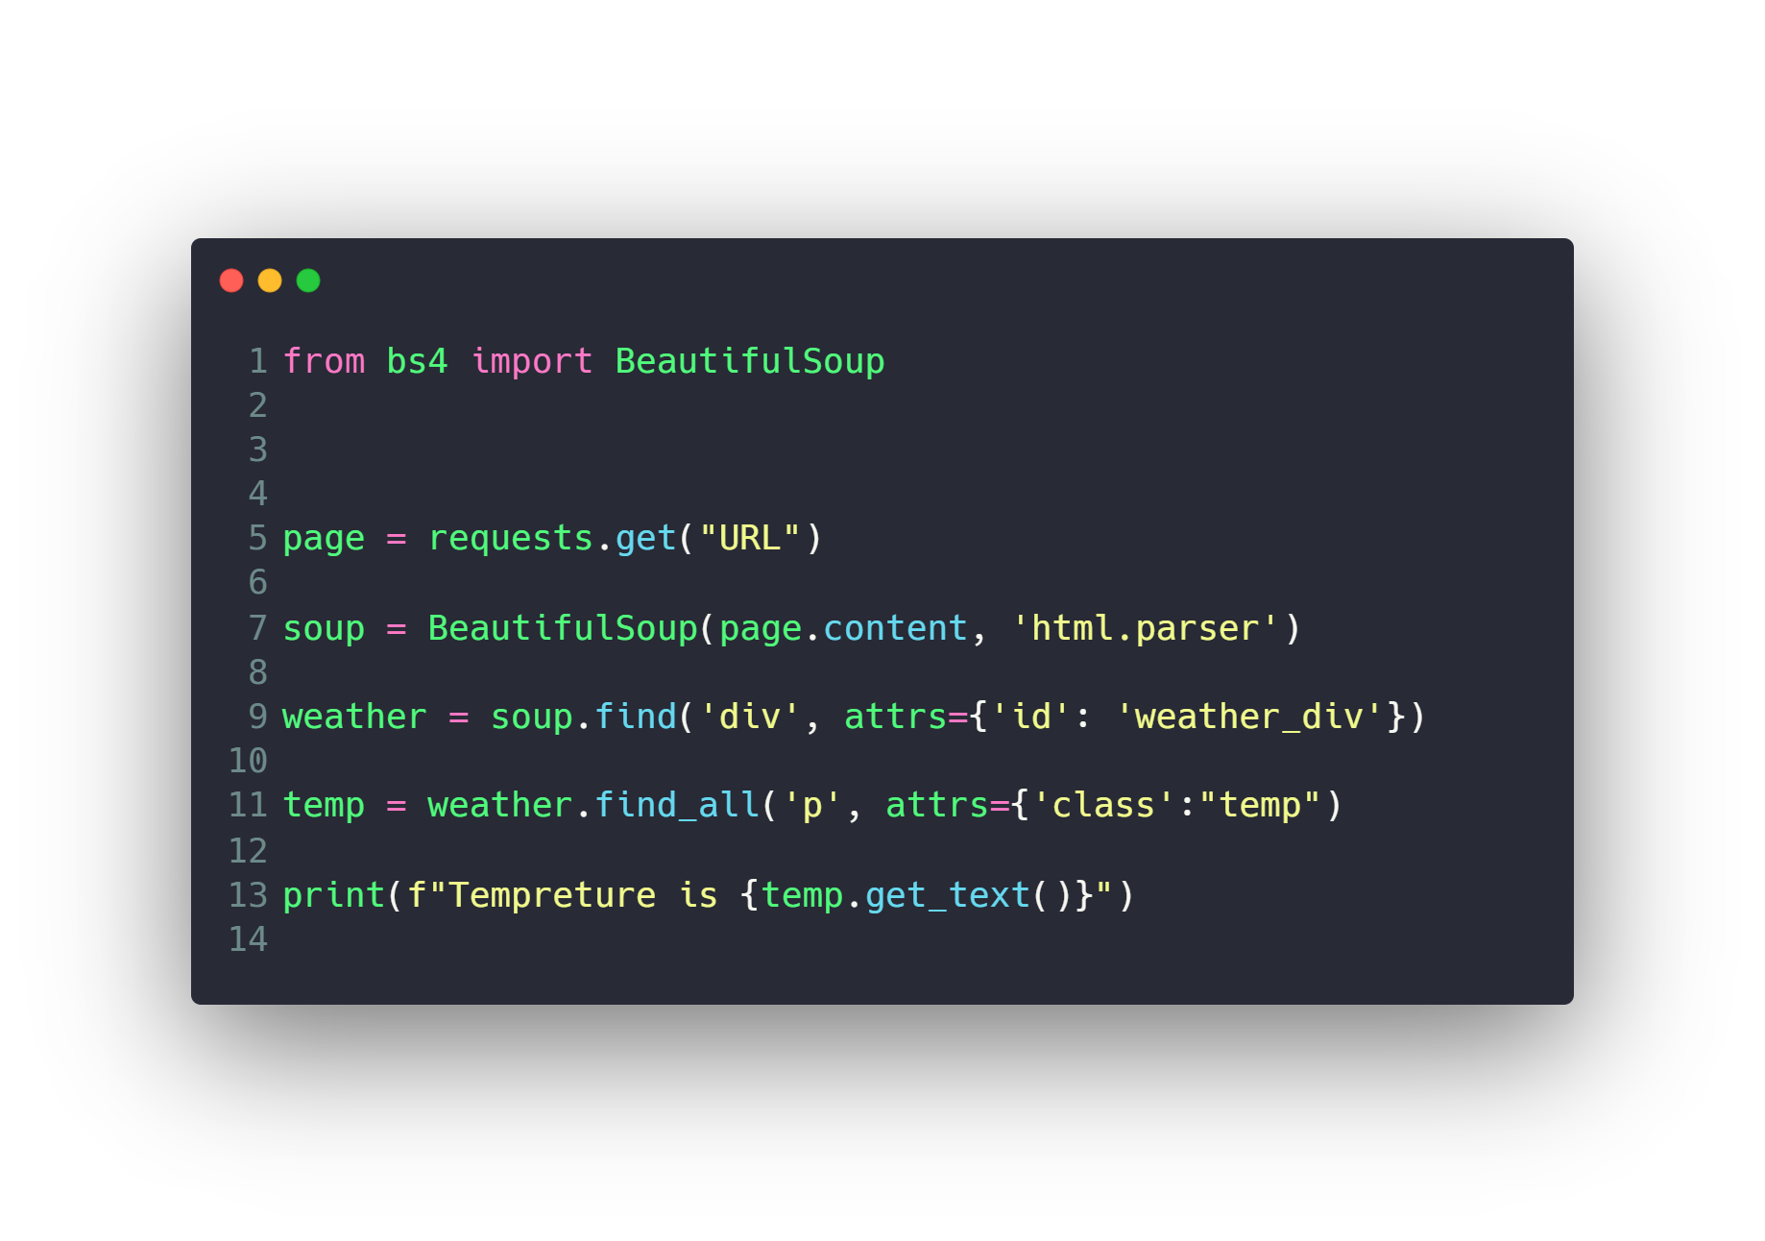
BeautifulSoap Library

Slide 32
Agenda
What is Network Topologies
What is Internet and Web Servers
HTTP Request/Response Cycle
HTML
CSS
Scrapping Concept
BeautifulSoap Library
REST API Web Services
Work with JSON

Slide 33
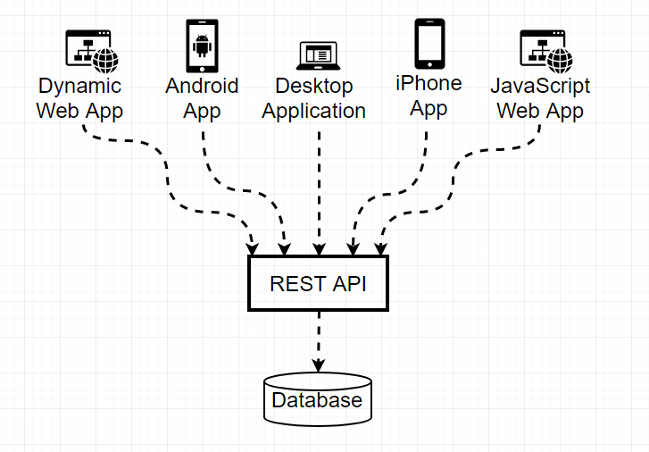
REST API Web Services

Slide 34
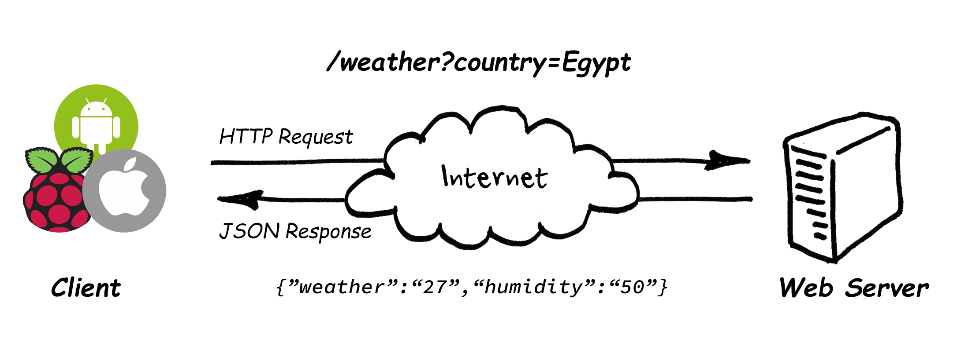
REST API Web Services

Slide 35
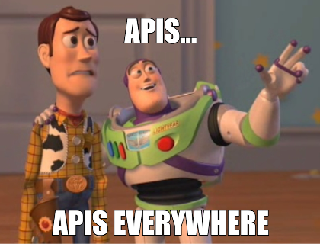
REST API Web Services
https://any-api.com/
https://github.com/public-apis/public-apis
https://cloud.google.com/products/ai
https://www.twilio.com/
....

Slide 36
Agenda
What is Network Topologies
What is Internet and Web Servers
HTTP Request/Response Cycle
HTML
CSS
Scrapping Concept
BeautifulSoap Library
REST API Web Services
Work with JSON

Slide 37
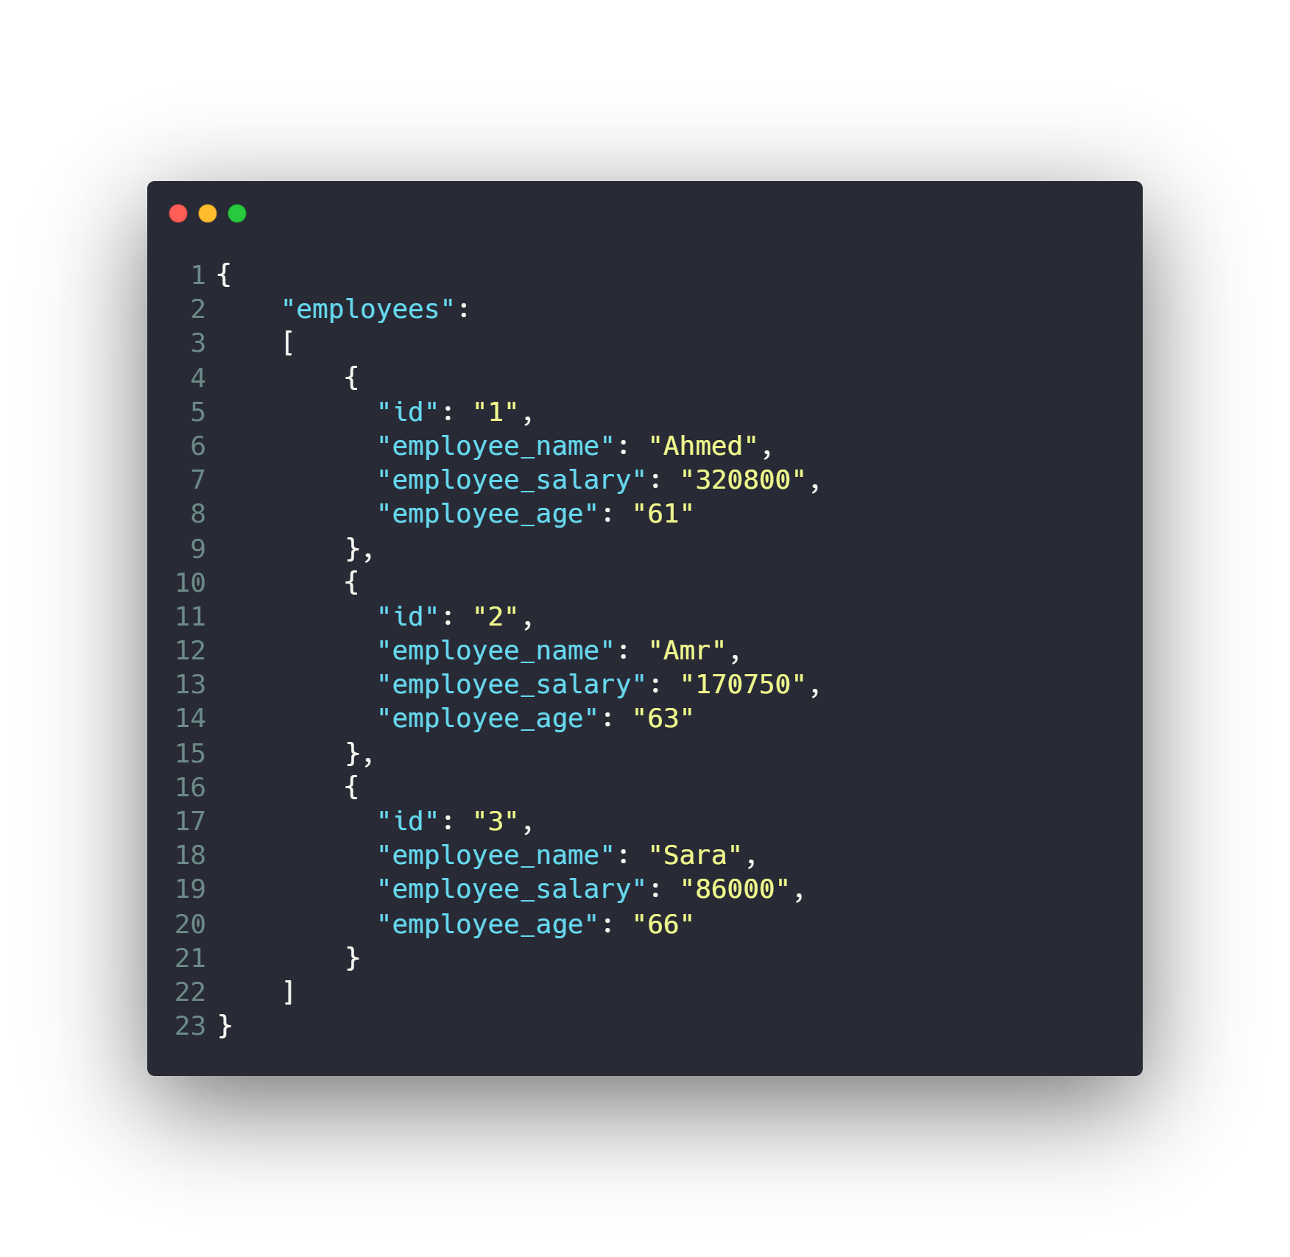
Work with JSON

Slide 38
Work with JSON
Install JSON Viewer extension
For chrome or firefox
https://chrome.google.com/webstore/detail/json-viewer/gbmdgpbipfallnflgajpaliibnhdgobh

Slide 39
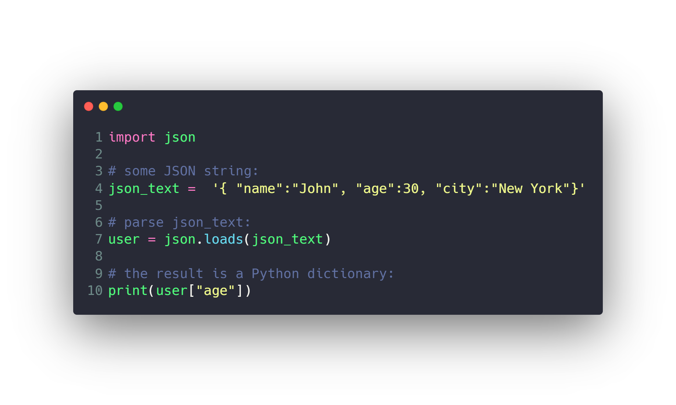
Work with JSON

Slide 40
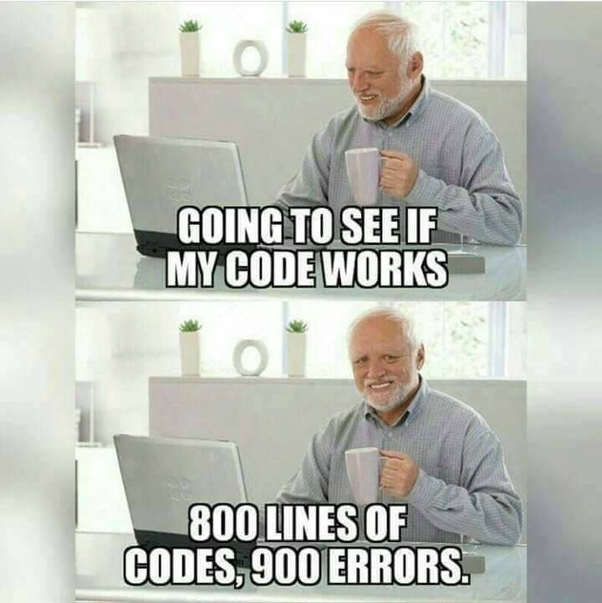

Slide 41
Questions ?!

Slide 42

Thanks! >_ Live long and prosper

